Slide 1
Product Presentation IRF150DM115
Technology: 150 V OptiMOS™ 5
Package: DirectFET™ MN Outline
May 2024

Slide 2
Table of contents
1
Introduction
  3
2
Application overview
  5
3
DirectFET™ advantages
  7
4
Application testing
  10
5
Summary
  14

Slide 3
Table of contents
1
Introduction
3
2
Application overview
  5
3
DirectFET™ advantages
  7
4
Application testing
  10
5
Summary
  14

Slide 4
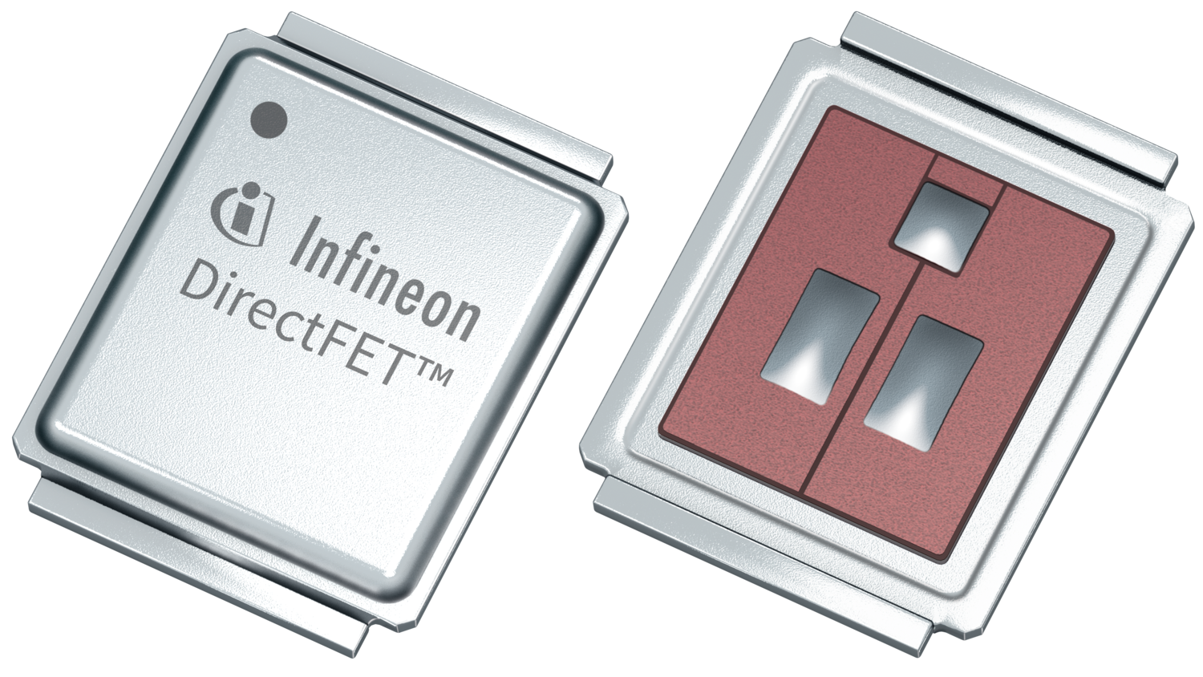
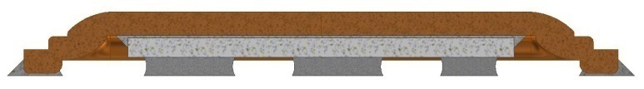
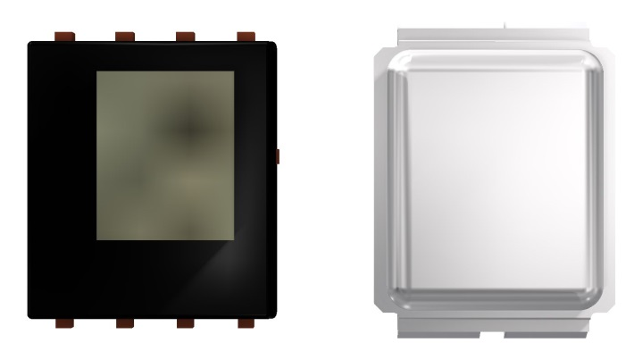
OptiMOS™ 5 150 V in DirectFET™ MN Outline
Product features
DirectFET™ package - MN Outline
Double-side cooled package
Low parasitic inductance
Low profile design
High current capability
100% lead-free (RoHS compliant)
Ag-filled epoxy die attach
Cu can
Silicon die
Pre-solder bumps
Product benefits
Enables designs with high power density
High efficiency
Minimized EMI
Optimized thermals
Board space reduction
Less device paralleling
DirectFETTM cooling area
14.6mm² without TIM
23.7mm² with 0.5m TIM
Key parameters
Part number | OPN | V_{DS} (V) | R_{DS(on)} max. @V_{GS} = 10 V (mΩ) | Q_{g} typ (nC) | package | Product status
IRF150DM115 | IRF150DM115XTMA1 | 150 | 11.3 | 33 | DirectFET™ MN Outline | Mass production

Slide 5
Table of contents
1
Introduction
  3
2
Application overview
5
3
DirectFET™ advantages
  7
4
Application testing
  10
5
Summary
  14

Slide 6



Target applications
Dual-side cooling and small form factor → compactness
Power optimizer MPPT – Booster
B6 topology
B6 topology

Slide 7
Table of contents
1
Introduction
  3
2
Application overview
  5
3
DirectFET™ advantages
7
4
Application testing
  10
5
Summary
  14

Slide 8
OptiMOS™ 5 150 V in DirectFET™ MN Outline
Volume and area optimisation
Top view
D²PAK
M-can
L-can
D-PAK
5 x 6.3 x 0.7 mm
Area: 32.1 mm²
Vol.: 22.4 mm³
7 x 9.1 x 0.7 mm
Area: 63.7 mm²
Vol.: 44.6 mm³
6.7 x 10.4 x 2.4 mm
Area: 70.1 mm²
Vol.: 166 mm³
6.7 x 10.4 x 2.4 mm
Area: 70.1 mm²
Vol.: 166 mm³
9% area reduction
73% vol. reduction
63% area reduction
95% vol. reduction
54% area reduction
87% vol. reduction
81% area reduction
97% vol. reduction

Slide 9

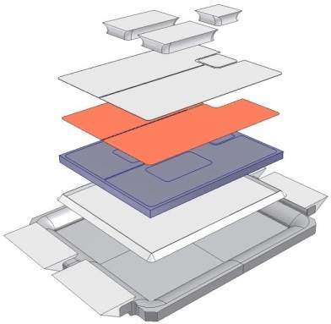


OptiMOS™ 5 150 V in DirectFET™ MN Outline
100% Pb free and RoHS 6 compliant!
DirectFET™
100% Pb free pre-solder pad
Uses epoxy as die attach material
DirectFET™ is a high-volume proven and high power package which is already RoHS 6 compliant!

Slide 10
Table of contents
1
Introduction
  3
2
Application overview
  5
3
DirectFET™ advantages
  7
4
Application testing
10
5
Summary
  14

Slide 11
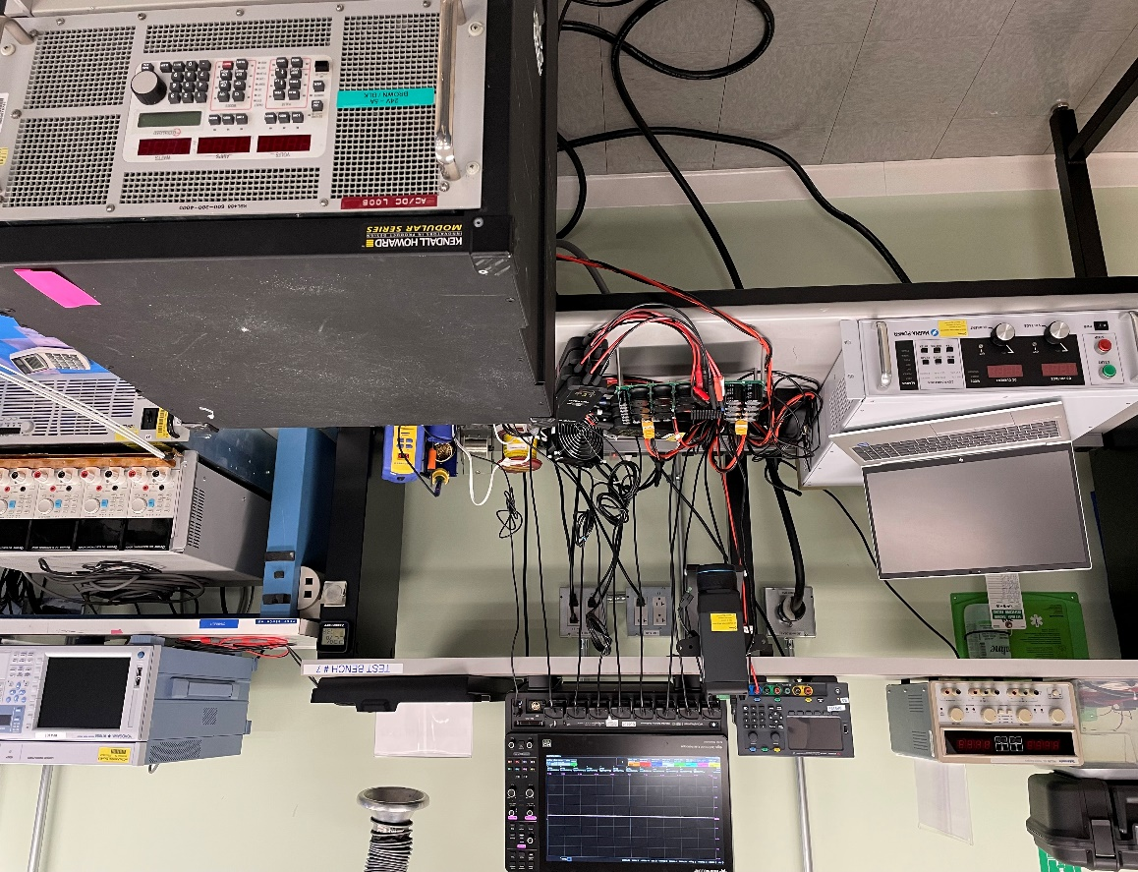
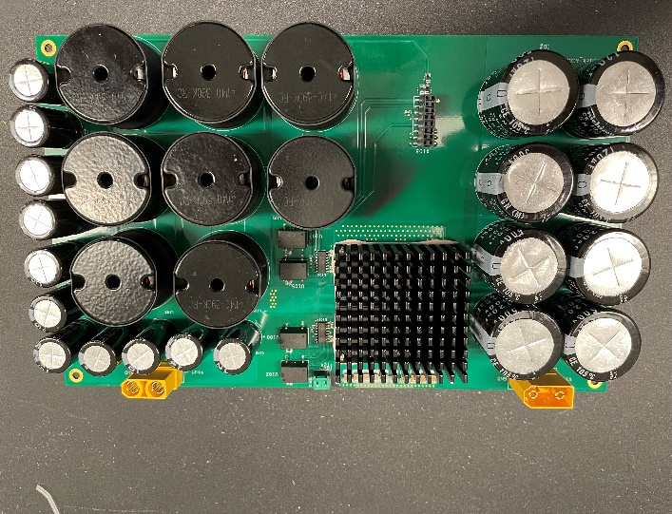
Application test
Series synchronous buck converter test setup
Oscilloscope
12V Supply
Test Board
Thermal camera
Test board
Power supply
Load
Part:
IRF150DM115
Test conditions:
Input voltage: 200 V
Load current: up to 27 A (~3 kW) with heatsink
Switching frequency: 40 kHz
Deadtime: 100 ns
Duty cycle: 56%

Slide 12
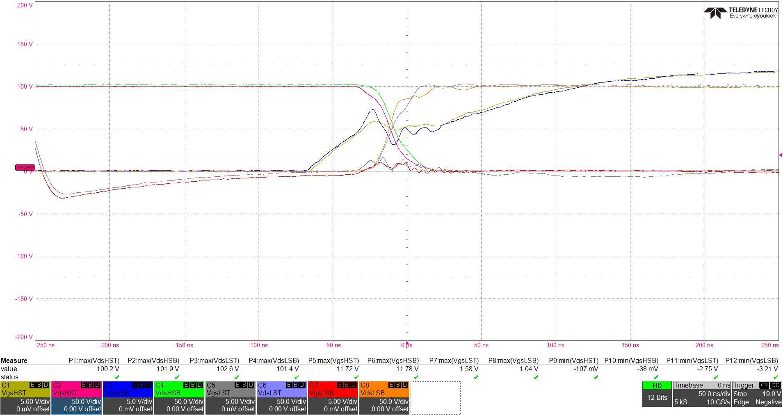
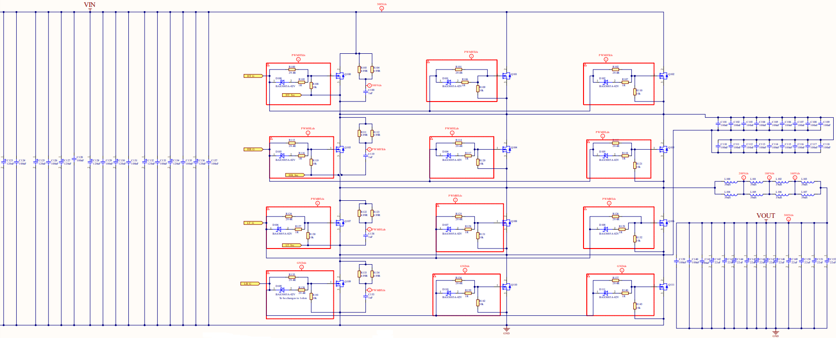
Application test
High-side turn-ON – smooth switching behavior
HS Bot Vds 50V/div: 101.9V
LS Top Vds 50V/div: 102.6V
HS Top Vds 50V/div: 100.2V
LS Bot Vds 50V/div: 101.4V
Schematic
HS Top x3
HS Bot Vgs 5V/div
1.04V
1.58V
LS Top Vgs 5V/div
HS Top Vgs 5V/div
LS Bot Vgs 5V/div
HS Bot x3
LS Top x3
DFET @ 27A Load Current
Rgon: 30Ω / Rgoff: 1Ω
LS Bot x3

Slide 13
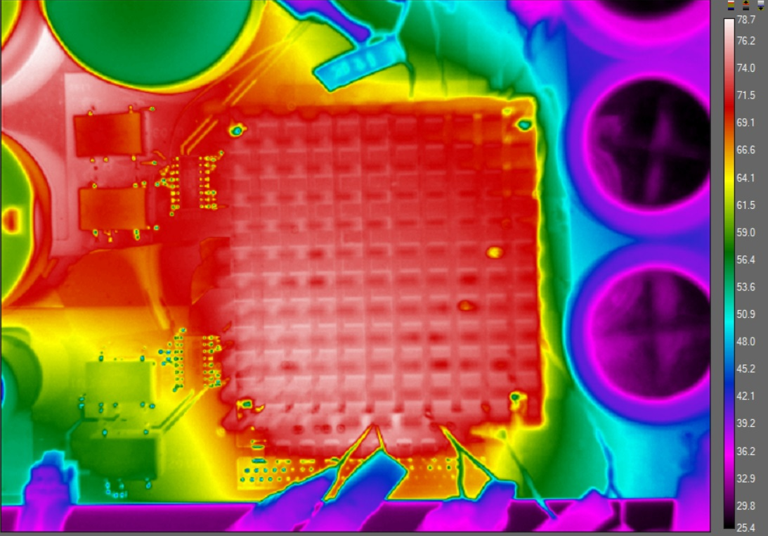
Application test
Temperature performance
DFET @ 27 A load current
Rg_{on}: 30Ω / Rg_{off}: 1Ω
Test conditions:
Input Voltage: 200 V
Load Current: up to 27 A (~3 kW) with heatsink
Switching Frequency: 40 kHz
Deadtime: 100 ns
Duty cycle: 56%
77ºC
With heatsink
Part | Temp °C @ 18 A | Temp °C @ 25 A | Temp °C @ 27 A
IRF150DM115 | 61.2 | 73.8 | 77
Without heatsink
Part | Temp °C @ 18 A | Temp °C @ 25 A | Temp °C @ 27 A
IRF150DM115 | 92.1 | 73.8 | 77

Slide 14
Table of contents
1
Introduction
  3
2
Application overview
  5
3
DirectFET™ advantages
  7
4
Application testing
  10
5
Summary
14

Slide 15
OptiMOS™ 5 150 V in DirectFET™ MN Outline
Summary
Surface mounted dual side cooled package enabling compact designs
Addressing multiple applications and topologies
RoHS 6 compliant

