Slide 1
EVAL_IMD700A_FOC_3SH
Quick Start Guide
Peter Green, Sergey Voskanyan
(IFAM PSS DCDC PD TM AE1 REN)

Slide 2
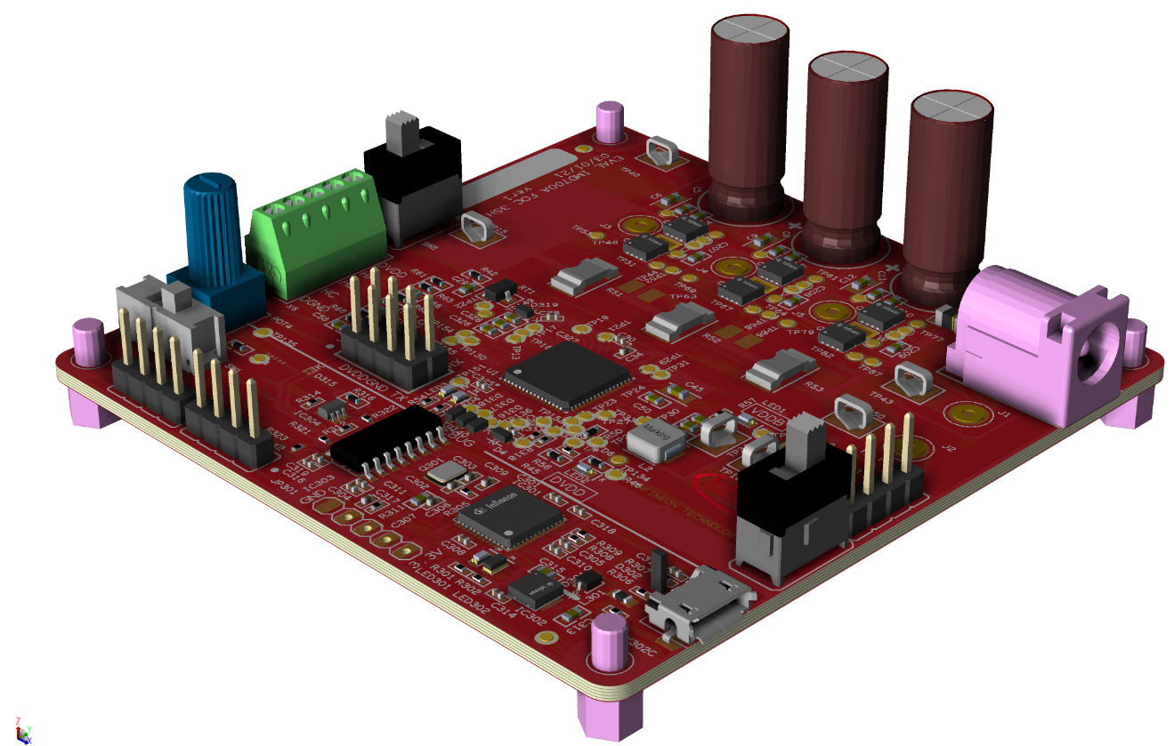
Product overview and features
Input and output at normal operation
DC input voltage 12 to 24 V, nominal 18 V.
Maximum input current 20 A
Output voltage three phase
Maximum output current per phase 15 A_{RMS}
Maximum output continuous power 300 W
Control scheme
Sensor-less field oriented control (FOC)
Switching frequency 20 kHz
Three current shunts
Protection features
Input fuse
Input reverse polarity
Output over current
Thermal shutdown

Slide 3
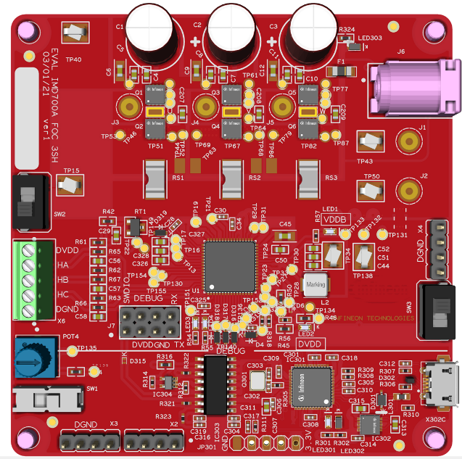
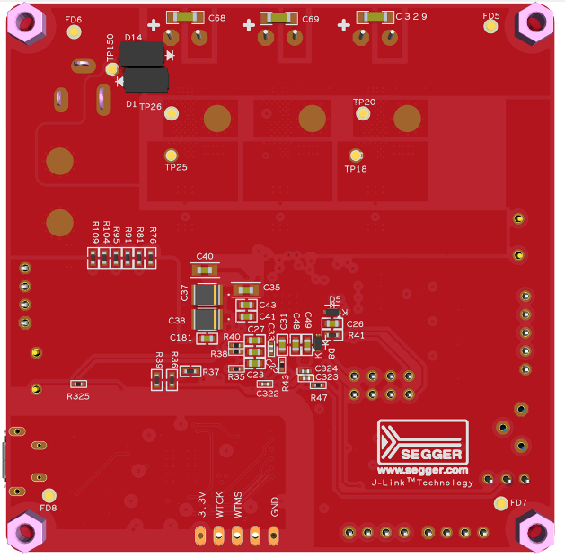
Demo kit description
Recommended operating conditions
Parameter | Minimum | Nominal | Maximum | Unit
LOAD (resistive) | - | 200 | 300 | W
DC Input voltage | 12 | 18 | 24 | VDC
DC input type | Bench power supply 25 A
Phase Current | - | - | 15 | ARMS
Switching frequency | - | 20 | - | kHz
Board view of EVAL_IMD700A_FOC_3SH
Use isolated DC supplies with current limit capability at 25 A or less are recommended
Use only with a 24V rated BLDC motor
Caution if using a battery as input voltage source.
WARNING!
The board should be tested only by qualified engineers and technicians.
Top Side
Bottom Side

Slide 4
Board test setup
IMPORTANT NOTE!
OBSERVE ALL SAFETY PRECAUTIONS!
Connect the motor phase outputs to the motor cables. Ensure that the correct BLDC motor with Hall sensors rated at 24V or above is used.
Set the brake switch to the disengaged position.
Set the direction switch as required.
Set the enable switch to enable mode.
Set the speed control to minimum (fully counter-clockwise).
Connect the PC through the USB cable if using the GUI
Connect the 24 V supply.
This can be through an adaptor jack or high current input terminals. If using high current inputs, ensure the correct polarity otherwise the board may get damaged. Polarities have been printed on the board.

Slide 5

Power and start procedure
To avoid the possibility of damaging the board, the following power up/down procedure must be followed:
Connect the GUI if required.
Turn on the 24 Volt auxiliary power supply.
Check all LED indicators are illuminated.
Slowly adjust the speed control and check that the motor is running, if not make sure the braking switch (if fitted) is released.
Set the motor direction via the switch or GUI
Adjust the motor speed as required via the potentiometer
Apply braking via the braking switch or GUI to stop and start the motor
VDDB is present
DVDD is present
Debugger DVDD is present
For further details refer to the application note:

Slide 6
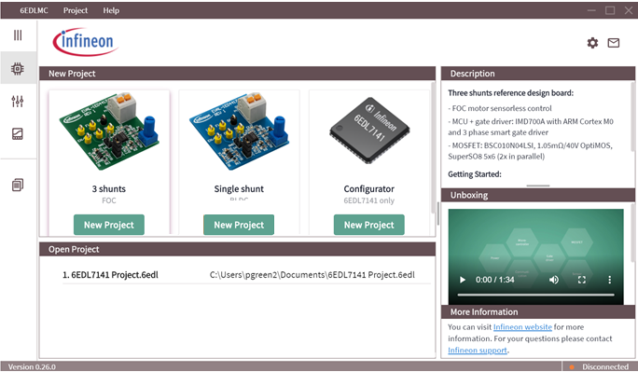
GUI setup (Landing page)
Click on highlighted button

Slide 7
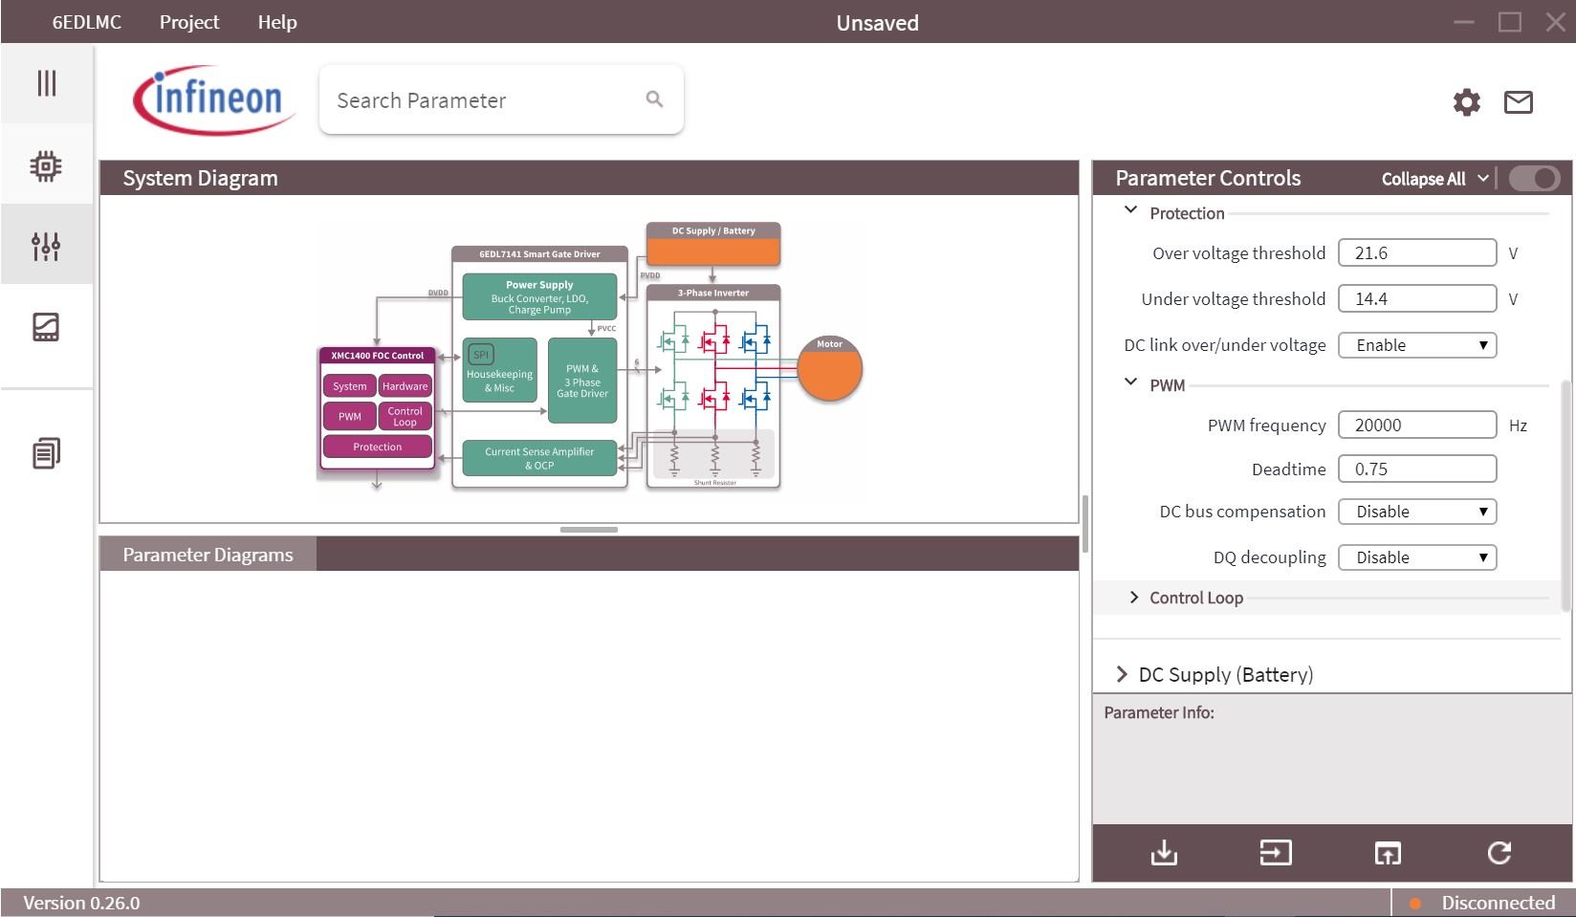
Flash the firmware from the GUI to the evaluation board
Select the desired firmware parameters
Click on highlighted button

Slide 8
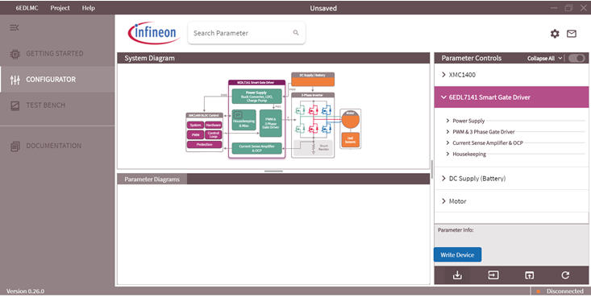
Setting the IMD700A parameters (not permanent)
Select the desired 6EDL7141 parameters in the GUI
Click on highlighted button

Slide 9
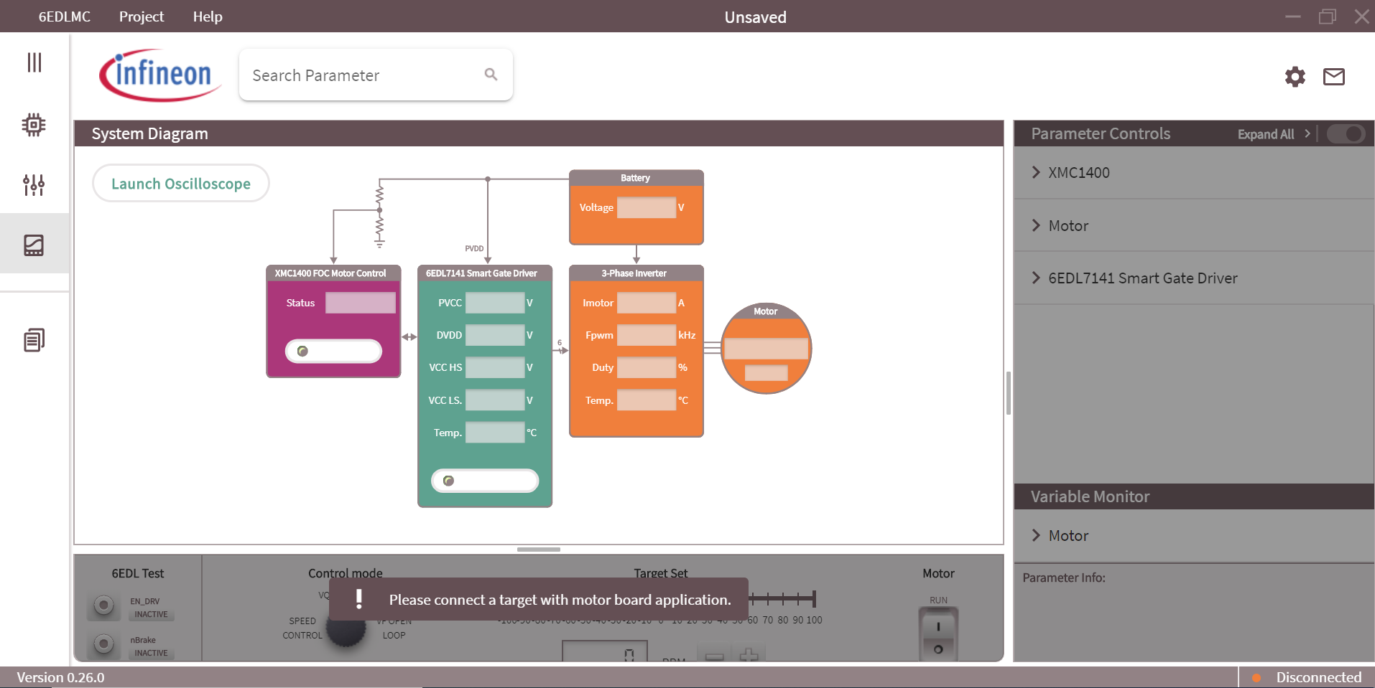
Set to test bench mode
Click on highlighted button

Slide 10
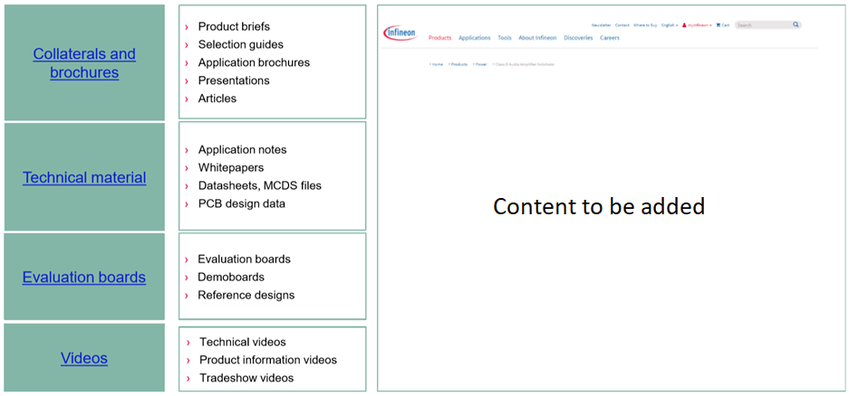
Support www.infineon.com/EVAL_6EDL7141_TRAP_1SH

Slide 11

Support
Online tools and services

Slide 12
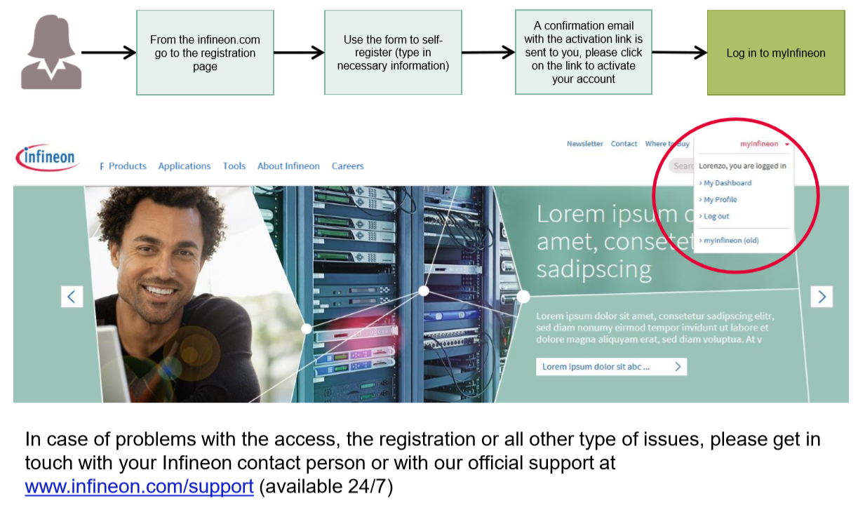
Tailor made information via myInfineon

