Slide 1
Fast EV charging
Trends and system solutions
Infineon Technologies AG
June 2023

Slide 2
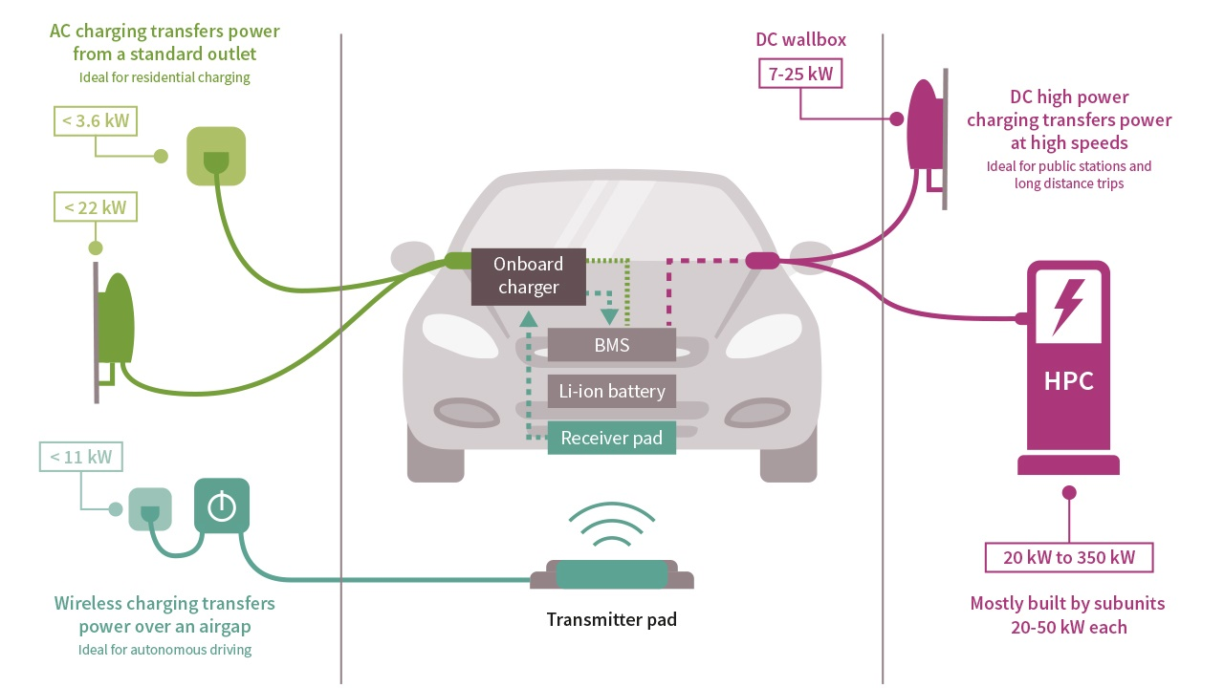
EV charging is a key strategic application for Infineon
We cover the full ecosystem from AC to high power DC charging
Connectivity solutions
Automotive systems
High power industrial systems
Wirless Charging
DC High Power Charging
Infineon targets the complete EV charging ecosystem from AC to high-power DC

Slide 3
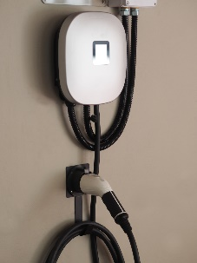
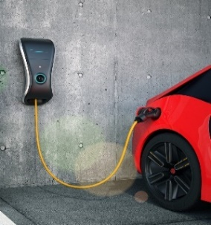
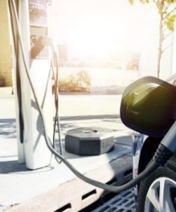
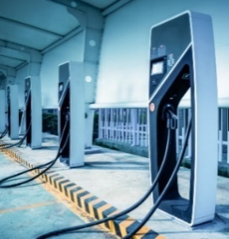


















Different use cases require different types of chargers, incentives and cost positioning will drive the total market
 |  | Residential AC wallbox | Residential DC wallbox | Commercial mid-power charger | Commercial high-power charger
Characteristics | Time to charge 40kWh battery | >2h | >2h | <1h | <20min
 | Place of installation | Residential and public domains | Residential and public domains | Cities, commercial, shopping areas | Charging parks, highways
 | Typical output power | 7-22kW | ≤22kW | 22kW to 50kW | >50kW
 | Bi-directionality possible | yes, with On-board charger | yes | yes | yes for (Bus) fleets
 | Preferred power implementation | No power content in charger
 | Beyond Power
Discrete power
Module solutions
Notes:
Within the DC charging its is all about the use cases: the market can be roughly divided in 3 classical use cases : residential, commercial Mid-Power and High Power Chargers .
This table gives an overview on the key characteristics of them.
For the user main characteristic is the time needed to charge a battery and the place of charger installation.
Technially this is reflected on charger side by diffrent typical output powers
and on number and size of the sub-power modules that are used,
as-well as in the interfaces to the users like methode of connectivity, HMI and methode of identification or payement.
For us the output power combined with the power concept translates into power component selection. In particular whether Si or SiC and whether discrete components or modules are preferred. And last but not least on the beyond power requirements and offering.

Slide 4
The addressable market is growing with ~20% CAGR
EV charging is an important contributor to Infineon’s growth
DC EV charger market in units
Semiconductor market in US$M
16% CAGR
20% CAGR
Source: DC Charging for Automotive 2023, Yole Development
Notes:
As DC EV Charging will play an important role for the success of xEV penetration
DC EV Charger market is expected to grow with about 16% CARG 2023-2028
Especially the highway charging infrastructure will have to grow above average, helping to boost the CAGR
for 50…200kW to 19%
and for >200kW even to 31%
This above AVG CAGR for higher powers will also fuel the semiconductor content growth to a 20% CAGR and by this makes it an important contributor to Infineon’s growth
(Internal Comment: This information is one of the latest official sources. We see the market much more aggressive and try to get customer feedback based on this official information to improve our Market Model for improving our production forecast)

Slide 5



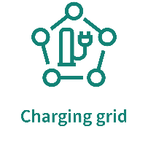











EV charging trends are unique in the market, SiC enables future power trends, intelligent control & secure connectivity enables IoT trends
Today
Gen 2
Gen 2+
Harsh operating modes
Higher efficiency
Wide voltage scalability
Bi-directionality
Energy integration
Higher efficiency 96% >> 98%
@ various operation modes
V2X (bi-directional)
Energy integration
up-to 100k cycles / lifetime
Changing operation modes
High temperature cycles
Wide voltage output 150V > 1000V
support with wide efficiency plateau
High power density >6kW/l
enables high space utilization
Reliability, harsh enviroment
Megawatt charger
High modularity and scalability
Harsh enviroment:
IP65, -45°C – 55°C
Higher voltages (1250V) and
Higher currents (up-to 3000A)
V2X (bi-directional)
Capable of being automated
Cooling optimization
Reducing fans improves
reliability and noise(<50dB)
22 kW
30 kW
50 kW
75 kW
75 kW
100 kW
Easy upgradability, scalability
Notes:
The key trends, linked to EV Charging, give some answers why Silicon Carbide is the perfect fit for this application:
<CLICK> all EV Charging systems have to fulfill harsh operating modes. And this is different to Photovoltaic or other power supply applications. While PV for example is typically operating one mode delivering power out of PV and usually has small- and typically smooth on-off cycles , EV Charging has to survive at high power cycles , changing operation modes, and high temperature cycles due to rapid power exchange.
On top, the environmental specs are similar harsh like photovoltaic: high humidity, reliable cooling and low noise are key enabler for todays designs.
<CLICK> Low noise is also one of the reasons why next generations have the need to move towards higher efficiencies, as this helps to reduce noisy, mechanical cooling and by this also is increasing the reliability.
But Silicon Carbide is not only enabler for high efficiency. With breakdown voltages of 1200 V and above Silicon Carbide can meet the requirement of wide voltage ranges of 150 to 1000V with significantly less compontents compared to a typical Silicon based solution.
Last but not least we also see higher adoption of bi-directionality and energy integration coming. With this not only power concepts for bi-directional power transfer are required and with this also the need for highly efficient active front end PFCs. Even more, for the higher power charging stations or bigger installations parks Photovoltaik and energy storage integration will become important, which results in unify designs on module level between EV Charging and PV + Storage designs.
<CLICK>
Looking more into the future we do identify higher adoption of bi-directionality and energy integration, here not only power concepts for bi-directional power transfer are important, but also several communication standards and services to be implemented , thus high demand for beyond power products. For the higher power charging stations or bigger installations parks PV and storage integration will become important which results in unify designs on module level between EV Charging and PV + Storage designs.
Finally later this decade the next sector of so called heavy or logistic mobility is expected to be electrified and battery or full electric solutions supposed to win against hydrogen in the mass mainly due to much higher energy budget (generation + consumption of a BEV truck is with >80% , 30% more efficient vs hydrogen)
Heavy fleet electrification will bring new challenges on the charging standards => so called megawatt charger is in upcoming specification (see separate slide for that)
-------------
<CLICK> How all those trends can be addressed with the help of Silicon Carbide, we nicely demonstrate with our EV Charging Reference Designs

Slide 6
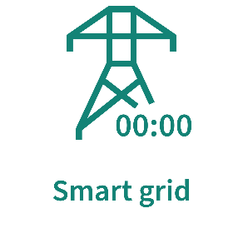
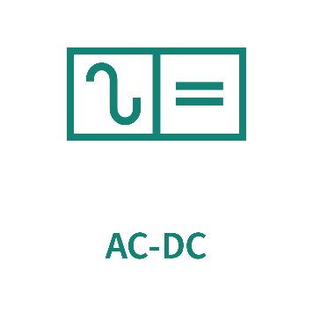
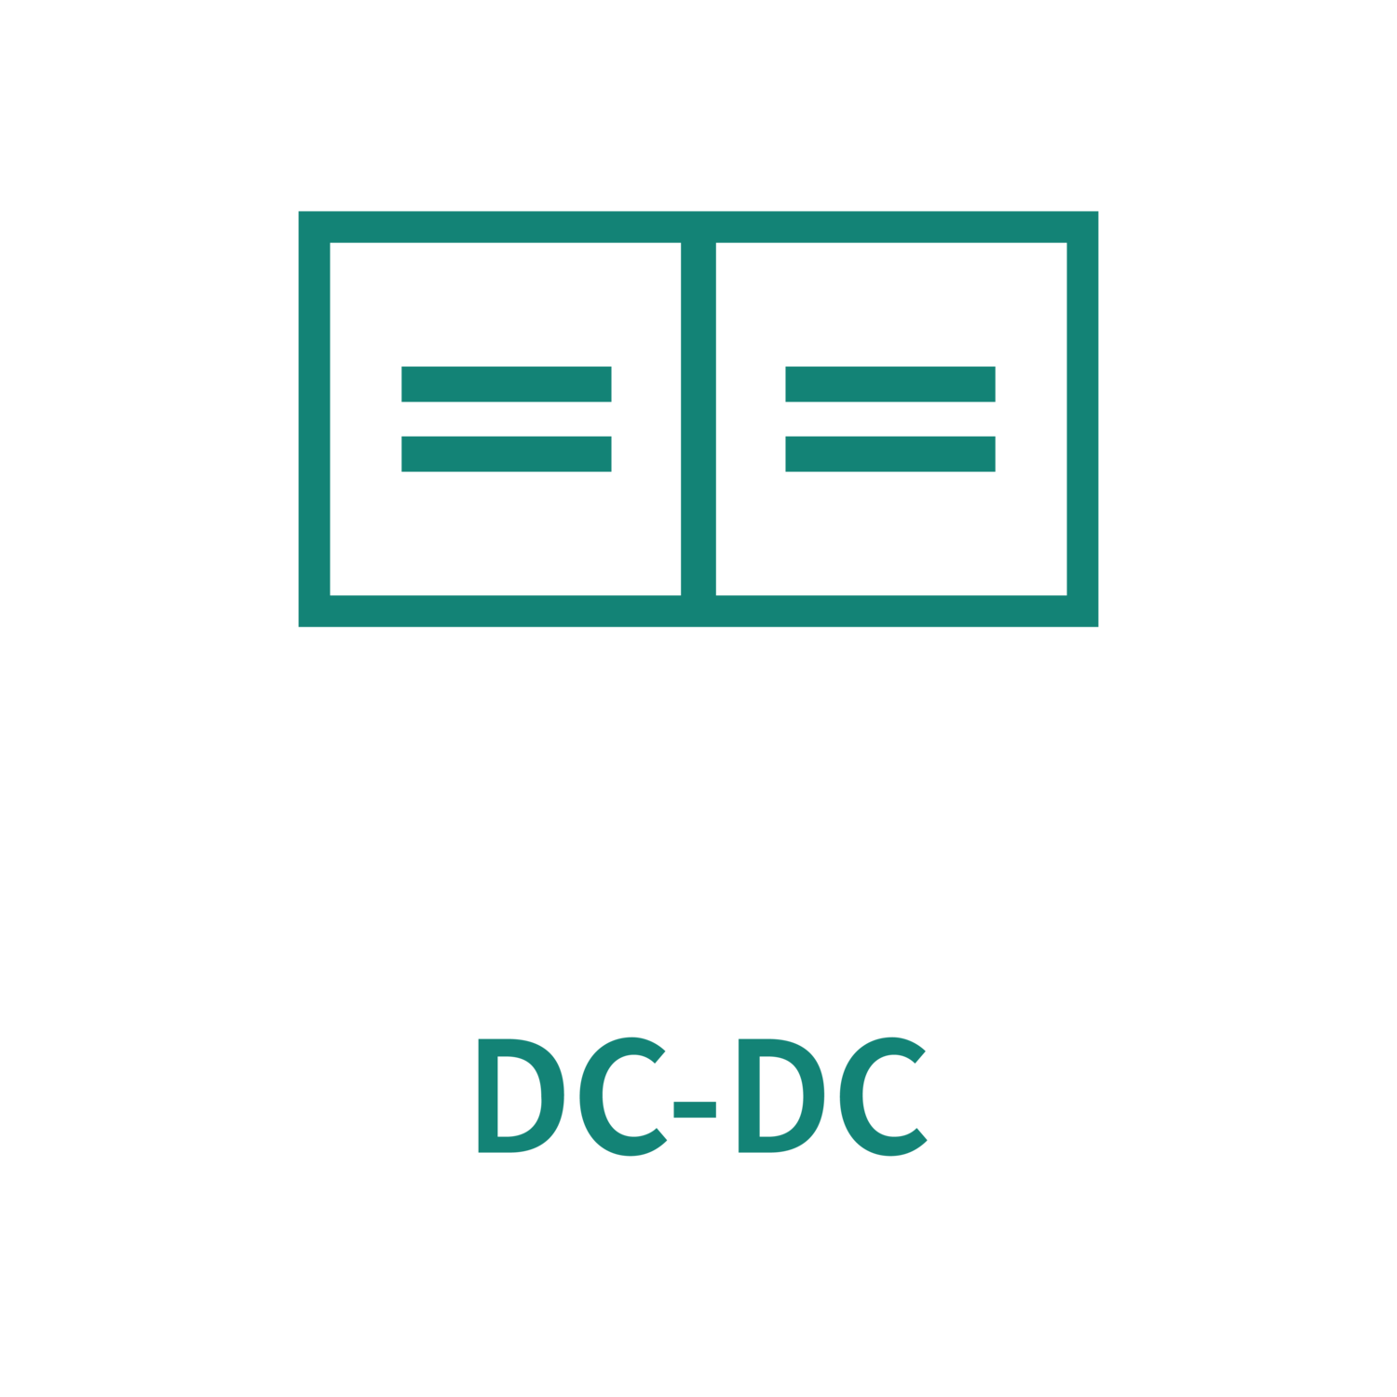
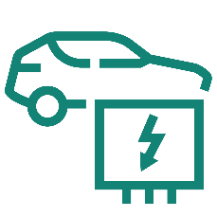

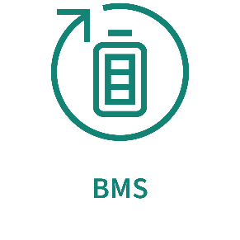
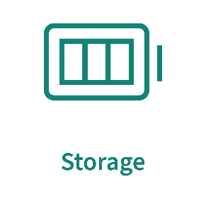
Structure of a DC EV charging system
Secure roaming & billing
DC-charger
AC-grid
DC-power
EV
Data
Cloud
Data
Data
DC-power
DC-power

Slide 7
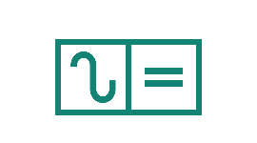


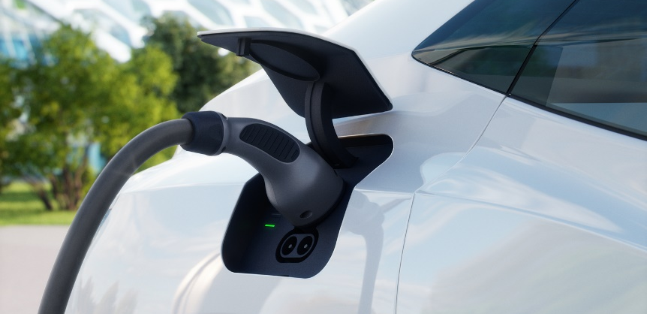


EV charging superstore - Infineon’s comprehensive product and solution offering for DC EV charging
Power density
Efficiency
Sense & communication
System control
XMCTM 1000, 4000, 7000
PSoC™ 6
AURIX™ TC377TP
Power stage
Easy Power Modules
IGBT Discretes
EiceDRIVER™ Gate drivers for SiC MOSFETs, & IGBTs with various safety features
Technologies
CoolSiC™
TRENCHSTOP™ IGBT7
CoolMOS™
CoolGaN™
Connectivity
Wi-Fi and BTBLE solutions
CAN transceiver
Sensors
Current sensors Integrated shunts & XENSIV™ TLI4971/2-A120T5-E0001
Security
OPTIGA™ embedded
security solutions
Secured communication/ secured host firmware update
OPTIGA™ Trust M
External memory
EXCELON™, HYPERRAM™ and SEMPER™ Flash and RAM solutions

Slide 8
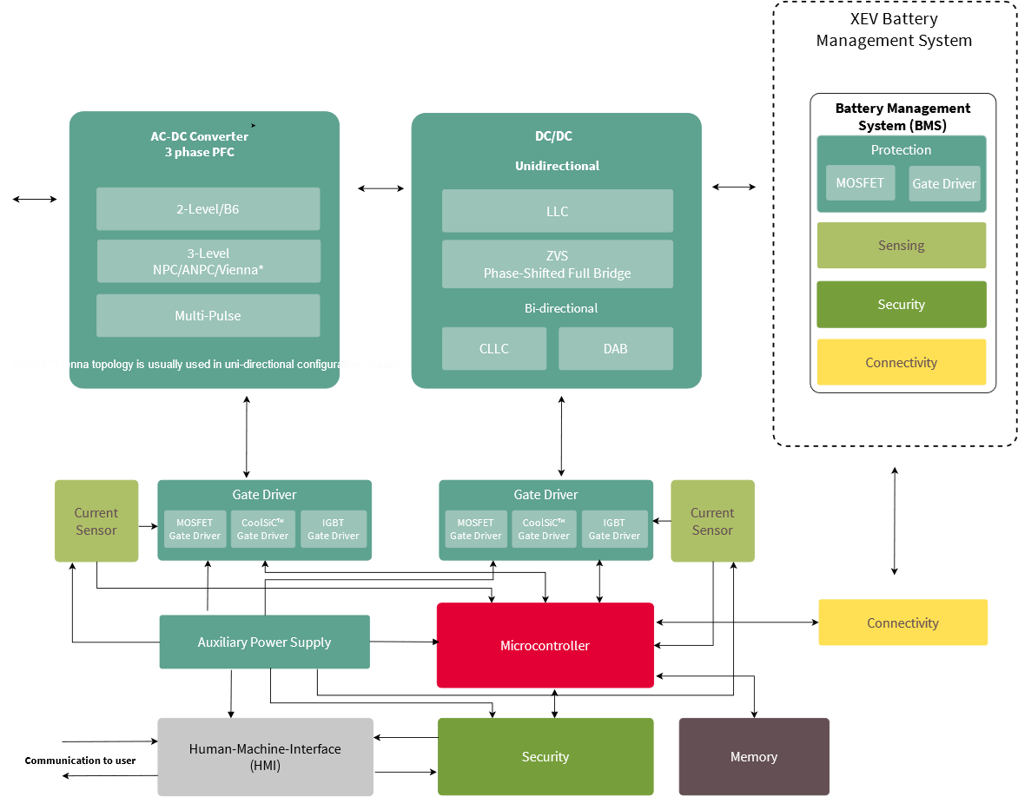
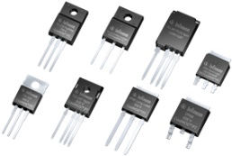

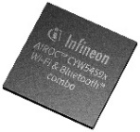
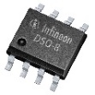
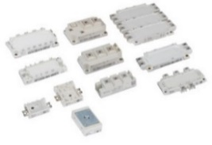
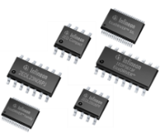
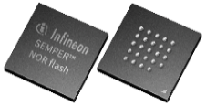

The application DC EV charger contains these key functional blocks
XMC™, AURIX™, PSoC™
CoolMOS™, CoolSiC™, IGBTs
discrete and modules
AIROC™, CAN Transceiver
OPTIGA™
EiceDRIVER™
Semper™
NOR FLASH
XENSIV™

Slide 9
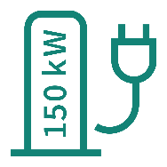




The perfect solution for every power class:
Infineon’s power solution positioning for DC EV charger
Discrete solutions
Module solutions
Gate driver solutions
Module based solution is recommended
100 kW
EiceDRIVER™ Enhanced
X3A/D (1ED34/38xx)
350 kW
Stacked modular solutions
6 x 60 kW
100 kW
350 kW
mainly module solutions
100 kW
Charging station
50 kW
EconoDUAL™
EiceDRIVER™ Enhanced
X3A/D (1ED34/38xx)
120/150 kW
4/5 x 30 kW
Stacked 50 kW modular solutions
50 kW
50 kW
EconoPACK™4
10 .. 30 kW
grey area
Up to
150 kW
grey area
Stacked 20 / 30 kW discrete solutions
20 kW
30 kW
Easy CoolSiC™
EconoPACK™4
EiceDRIVER™ Enhanced X3A/D (1ED34/38xx)
EiceDRIVER™ Compact
X3C (1ED31xx)
1ED-MF/AF
50/60 kW
20 kW
Charging pile
20 kW
30 kW
?
D
10 kW
iscrete
IGBT
solutions
IGBT TRENCHSTOP™ 5 / 7
30 kW*
Easy CoolSiC™
EconoPACK™4
EiceDRIVER™ Compact
X3C (1ED31xx)
1ED-MF/AF
EiceDRIVER™
1EDB8275x
2EDS8265x
2EDF9275x
?
≤ 60 kW
mainly discrete solutions
DiscreteMO
Discrete solution is recommended
SFETsolutio
Wallbox /
DC-subunits
IGBT TRENCHSTOP™ 5 / 7
20 kW*
Microcontroller: XMC1000, XMC4000, XMC7000, AURIX™ TC377TP, PSoC™ 4/6
OPTIGA™, AIROC™, Current sensor: XENSIV™ TLI4971, 1700 V CoolSiC™ MOSFET for Auxiliary Power Supply
* DC charger subunit or DC charger

Slide 10

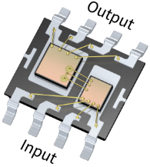
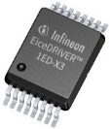
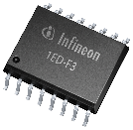


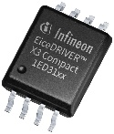
Every switch needs a driver, the right driver makes a difference
EiceDRIVER™ isolated gate driver portfolio
Rich feature-set for advanced protection:
F3 (1ED332x): Cost effective solution with DESAT
X3 Analog (1ED34xx): Best-in-class DESAT accuracy, analog configurability
X3 Digital (1ED38xx): I2C configurable enabling predictive maintenance
EiceDRIVER™
Enhanced
Up to 2300 V, 9 A
DESAT, Miller clamp
www.infineon.com/gdenhanced
EiceDRIVER™
Compact
Up to 2300 V, 18 A
Miller clamp, 2-level slew-rate-control
Reduced feature-set and easy to design-in:
X3 Compact (1ED31xx): easy to design & cost effective
2L-SRC Compact (1ED32xx): EMI & switching loss optimization
  New products with Reinforced isolation (UL 1577 and VDE-11)
www.infineon.com/gdcompact

Slide 11


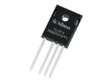

Typical solutions for chargers from 30 kW to 150 kW using discrete devices
Stacking of subunits
Vienna rectifier,
Active Front End (AFE)
for PFC Stage
600 V CoolMOS™ P7
650 V IGBT TRENCHSTOP™5
1200 V CoolSiC™ Schottky Diode
EiceDRIVER™ isolated gate driver
3-phase AC input
Galvanic isolation within the subunit
Resonant converter
e.g. interleaved 3-phase,
Multiphase Buck Converter
for DC/DC Stage
600 V CoolMOS™ CSFD and CFD7
1200 V CoolSiC™ MOSFET
650 V / 1200 V CoolSiC™ Schottky Diode
EiceDRIVER™ isolated gate driver
Power of subunit
15-30 (50) kW
EMI Filter
AC/DC
Vienna Rect.
DC Link
DC/AC
Primary side
Galvanic Isolation
AC/DC
Secondary side
DC Filter

Slide 12




Typical solutions for chargers from 50 to 350 kW using power modules
Stacking of subunits
Vienna rectifier,
Active Front End (AFE)
for PFC Stage
CoolSiC™ Easy Module
IGBT EconoPACK™
IGBT EconDUAL™
Diode Rectifier module
EiceDRIVER™ isolated gate driver
3-phase AC input
Galvanic isolation within the subunit
Resonant converter
e.g. interleaved 3-phase,
Multiphase Buck Converter
for DC/DC Stage
CoolSiC™ Easy Module
IGBT EconoPACK™
IGBT EconoDUAL™
EiceDRIVER™ isolated gate driver
CoolSiC™ Easy Module
IGBT EconoPACK™
IGBT EconDUAL™
Power of subunit
(30) 50-75 kW
EMI Filter
AC/DC
DC Link
DC/AC
Primary side
Galvanic Isolation
AC/DC
Secondary side
DC Filter

Slide 13
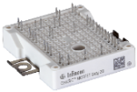
Example power converter BOM
High efficiency 50-60 kW design (Bi-directional)
2 X FS13MR12W2M1H(P)_B11
2 x FF11MR12W2M1H(P)_B11
EMI Filter
2-level Active Front End rectifier
DC Link
Dual Active Bridge DC/DC converter
(Primary and secondary side)
Key features and benefits
Bidirectional
Highest efficiency with CoolSiC™ technology
BOM parts reduction
Higher reliability
Low design complexity
Fast time to market
(*)
Application assumptions
Topology: NPC2 in AC-DC stage and 3-phase CLLC or DAB in DC-DC stage
60 kW, 120 A @ 500 V
Liquid cooled
Switching frequency 120 kHz for DC-DC Converter
Stage | Switching Freq. | Devices | Product | Part number | Pcs
AC/DC | 40 kHz |  | 1200 V CoolSiC™ Easy 2B | FS13MR12W2M1H(P)_B11 | 2
 |  | Driver IC | EiceDRIVER™ 1ED | 1ED3124MC12H | 6
 |  | Sensor | XENSIV™ magnetic current sensor | TLI4971-A120T5 | 3
DC/DC | up to 300 kHz |  | 1200 V CoolSiC™ Easy 2B | FF11MR12W2M1H(P)_B11 | 4
 |  | Driver IC | EiceDRIVER™ 1ED | 1ED3124MC12H | 8
µC |  |  | AURIX™ microcontroller | TC377TP | 1
*) Simplified schematic diagram. Symbols for the schematic diagram are only for illustration purposes and does not refer to the proposed bill of material.

Slide 14
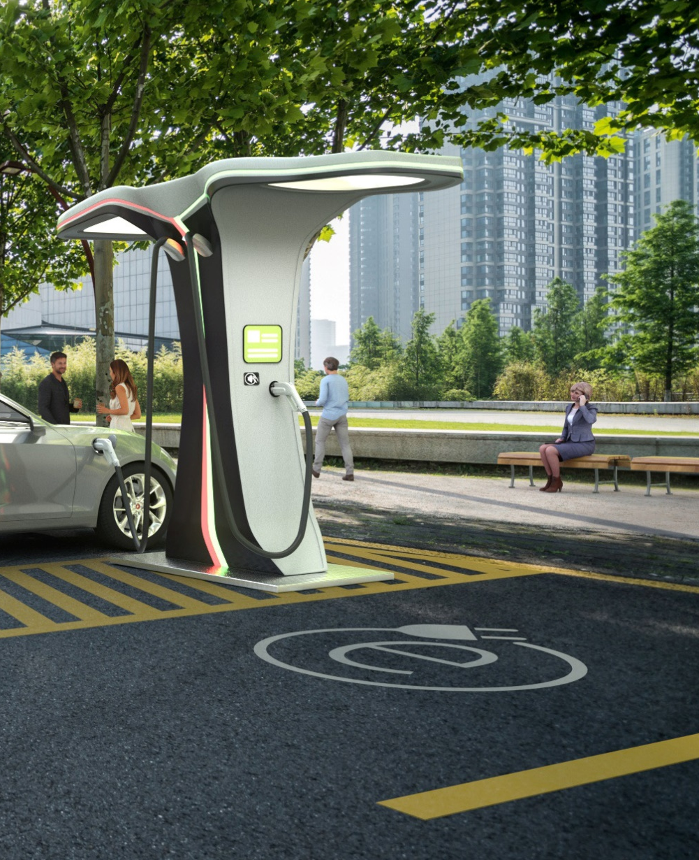



CoolSiC™ helps to cut charging time for electric vehicles by 50%
EMI Filter
AC/DC
.
DC Link
DC/AC
Primary side
Galvanic Isolation
AC/DC
Secondary side
DC Filter
Advantages of SiC
CoolSiC™ MOSFET reduces charging time at the same charging station and footprint
One 1200V CoolSiC™ MOSFET is sufficient to support a DC-link voltage of 800V as well as bi-directional operation
Due to 50% lower conduction and switching losses from lower Coss the overall efficiency can be increased which lowers the cooling effort → > 97% total efficiency at full load
High switching frequencies leads to less noise

Slide 15


Why SiC: SiC enables up to 2% efficiency gain in DC EV charger applications compared to Si-based solutions
SiC-enabled efficiency gain example:
AC-DC* stage: up to 0.8%
DC-DC** (LLC) stage: up to 1%
∑ ~1.8% total system efficiency gain
by changing from Si to SiC
~33% higher power density
  Smaller designs and less weight, e.g., for DC wallbox application
  Higher power utilization within the same space → faster charging
Less cooling effort
  Less active cooling, fewer mechanical components → increased reliability
  Lower noise level for usage in residential areas
Energy cost and CO₂ savings
  ~2% efficiency = 2 kW energy saving for 100 kW charging power:
  ~1.000 € energy cost savings annually*
  ~7 tons of CO₂ savings annually*
* @ AVG 10h operation/day & 0.15€/kWh electricity costs
* e.g. Vienna rectifier SiC- vs. Si-Diode efficiency measurement
** LLC 30 kW Si vs. SiC
%
2022-11-22
Notes:
Our measurements and simulations on typical EV Charger topologies showed that when switching form Silicon to Silicon Carbide you can safe up to 1% on the DCDC stage and up to 0.8% on the AC-DC stage, resulting in a total saving of about 1.8%
But what does this mean for the application?
<CLICK> This saving enables about 33% higher power density
what enables smaller designs and less weight e.g. for realizing DC wallbox applications
Or a higher power utilization within the same space to realize higher charging powers and with this faster charging
<CLICK> Less cooling effort will have also additional benefits:
By reducing the mechanical cooling effort you reduce also the amount of mechanical components like fans and filter mats what results in an increased reliability to improve the charger uptime
Less cooling also results in lower noise levels for usage of chargers in residential areas
<CLICK> Last but not least it of course also saves Energy costs and CO2 savings that sum up for 100kW charging power to about 550€ per year energy cost savings and 7 tons of CO2 savings.
<NEXT PAGE>

Slide 16
Infineon products addressing EV charging needs beyond power
MCU
Secure Connectivity
Sensors
Isolation
Memory
PSoC™ 4: Most flexible and scalable
low power mixed-signal architecture
Cortex®-M0+ cores combined with mixed-signal hardware IP &
CapSense™
AIROC™ Wi-Fi + Bluetooth Combos
802.11a/b/g/n/ac/ax Wi-Fi and Bluetooth® 5.2 in a single-chip solution
Can be coupled with external MCUs
via RTOS, along with Linux on MPUs
XENSIV™ Current Sensors
Minimal insertion inductance (220 µW
& resistance <1 nH)
High dynamic range, high peak current
Thermal performance
Fast OCD
Small size
ISOFACE™ Digital Isolators
2-channel and 4-channel Digital
Isolators for functional and safety isolation with highest robustness, accurate timing performance and
low power consumption
EXCELON™ F-RAM
Read/write endurance of 100 trillion cycles to log data continuously
Low pin count, 108 MHz QSPI interface that is as fast as a parallel interface
PSoC™ 6: Purpose-Built for the IoT
Combining Cortex®-M4 and Cortex®-M0+, industry-leading ultra-low power, flexibility & security for the IoT
AIROC™ Bluetooth & Multiprotocol
SoCs
Bluetooth Classic, BLE and BLE Mesh solutions
XENSIV™
MEMS microphones
Magnetic, Pressure, CO₂ , Radar or
ToF 3D image sensors
HYPERRAM™
High read/write (800 MBps) bandwidth for maximum system performance
Low pin count, small form factor for system cost savings
Hybrid sleep mode and partial array refresh for low power
XMC™ Industrial Microcontroller
Real-time control with application specific peripheral
OPTIGA™ Trust
Offering rock-solid hw security for IoT devices
Pre-provisioned with easy cloud onboarding
SEMPER™ NOR Flash
Market leadership with the world's most safe, secure, and reliable NOR solutions
AURIX™ 32bit TriCore™ Microcontroller
The AURIX™ family with its embedded safety and security features is the
ideal platform for a wide range of automotive and industrial applications
OPTIGA™ Connect
Turnkey eSIM security solutions

Slide 17
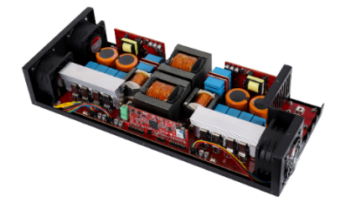

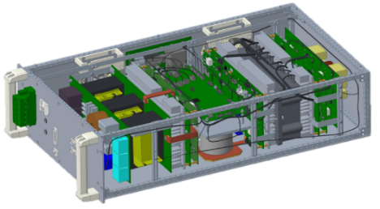
Infineon reference designs for different DC EV charging systems
Home
11 kW bi-directional DC-DC converter:
REF-DAB11KIZSICSYS
Public
22 kW DC wallbox: in development
Up to 50 kW DC charger subunit
for high power charging systems:
Highway
Release planned for Q3 - 2023

Slide 18
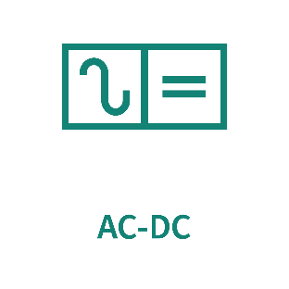






EV charging application trends, requirements, and designs are supported by Infineon's comprehensive solution offerings
Energy
efficiency
Bi-
directionality
REQUIREMENTS/ TRENDS
Power
density
Reference designs
Scalability
Visit www.infineon.com/ev-charging for more information

Slide 19







Support Material
Consolidated overview
Fast EV Charging Link
Chargers up to 150 kW Link
Chargers from 50 kW to 350 kW Link
DC wallbox Link
Reference designs & boards
11 kW SiC bi-directional DC/DC converter board for EV Charging Link
Reference design user guide Link
Demo board / kits Link
Evaluation boards Link
Documents
Application presentation Link
Whitepaper – How to make the charging infrastructure for electric vehicles smart Link
Whitepaper – Realizing the future of fast EV charging through CoolSiC™ based topology design Link
Videos and podcasts
Podcasts Link
Videos Link
Trainings
Online Trainings Link
Webinars Link

