Slide 1
OPTIGA™ TPM SLB 9673
A future-proof new generation TPM with I2C interface
Infineon Technologies
September 2023

Slide 2


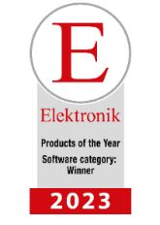
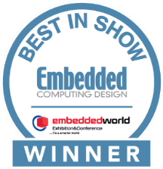

Infineon’s award-winning TPM technology
Several awards testify to the innovative strengths
and advanced cryptographic capabilities of
Our OPTIGA™ TPM SLB 9672/9673 solutions
“Embedded Award 2023” from Embedded World
First place in the “Safety&Security” category
“Best in Show” award from Embedded Computing Design
Top spot in the “Security” category
Product of the Year” award from ELEKTRONIK
First prize in the “Software” category

Slide 3




Why security is essential
Security is a fundamental
need of society with increasing importance
The connected world is further driving the demand for security
We believe in hardware-based security as the essential trust anchor

Slide 4


TPM as
Root of Trust

Slide 5
Securing systems starts by securing components with hardware-based roots of trust
Central Computer
Plant
level
Server
Secured
plant
Industrial PC/Panel PC
Secured
network
HMI
HMI
Secured
system
Supervisory
level
Secured
component
Foundation
Field device
PLC/micro PLC
Linear actuator
Field
level
HMI
Control
level
Motor control
Notes:
In order to protect industrial plants, it is necessary to implement security at the lowest possible level, meaning it is necessary to implement appropriate security measures starting at the component level. A component in this sense is an industrial components like a Industrial PC.
Those components are then used as basis for industrial systems, networks and eventually are comprised in those plants.
On the component level, it is necessary to securely store the digital identities as a basis for strong means of authentication. In addition it is of high important to implement measures for device integrity and/or for secured FW and SW Updates (here is is necessary to make sure that only valid updates from the correct source are installed)
Infineon OPTIGA™ products contribute as core elements to enable securing device components and as such help to secure industrial systems, networks and eventually plants
(Additional info: securing industrial plants consist of multiple actions. Integration secure elements as basis is only one of the multiple facets of securing industrial equipments up to plants)

Slide 6


Discrete TPM, key Root-of-Trust for multiple applications
Key targets of discrete TPM
Forecasted markets for discrete TPM
PC & laptops
A stable base market and significant growth in other segments
Market size (in M pcs)
Professional PCs
Industrial PCs
Servers
Servers
IoT networking
Network Interface Cards
Networking equipment
Printers

Slide 7


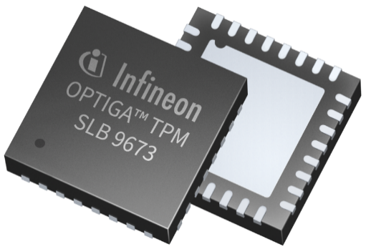

Quick facts about TPM with an I2C interface
Programmable
Logic Controller
Smart factory
Smart building
IoT networking
Target
applications
Fully standardized certified security solution supporting future-proof PQC-protected FW Update mechanism
Allows trusted and secured communications with I2C up to 1MHz
Supports the latest TPM 2.0 specs and corresponding security requirements
Meets demanding requirements with operating temperature range from -40 up to +105°C
Simple integration with Linux-based OS thanks to easy-to-understand materials
and sample codes on GitHub
Well suited for embedded system where simplicity of design and lower system BOM cost are important

Slide 8

Future challenges
for TPM

Slide 9


The threat of quantum computers to cryptography
Within the next 10 to 20 years,
quantum computer attacks on today’s cryptography are expected to become reality.

Slide 10
Quantum computers, a threat to currently known security algorithms
Asymmetric cryptosystems (RSA/ECC):
Completely broken using Shor’s algorithm
Symmetric cryptography:
Security levels halved by Grover's algorithm
Currently
Quantum world
Currently
Quantum world
ECC-256 and RSA-3072 have 128-bit security
Almost no security
AES-128 has 128-bit security
64-bit security
Quantum world
(in 10 – 20 years)
Heavily affected:
RSA, ECDSA, ECDH
Affected:
AES-128, 3DES
Currently considered safe:
AES-256, SHA256¹, SHA512,
SHAKE256, SHA3-512, …
1 Preimage resistance
Notes:
In a quantum world, PQC will essentially become what RSA and ECC are today.

Slide 11




Considered timeline
Devices with over 10 years lifecycle must be prepared for the quantum computing age
5 – 8 years
2035
Expected availability of quantum computers
that could be used for cryptoanalysis
3 – 10 years
Need of PQC
Future Proof TPM
Average 15 years lifetime
Components in field for 20 – 30 years
2022
2025
2030
2035
2040
2050

Slide 12



The security of TPM applications can only be as high as the one of the firmware update mechanism
In the past
Today
In the near future
Embedded device
Firmware update mechanism
128-bit classical security
Embedded device
Firmware update mechanism
128-bit PQC security
Embedded device
Firmware update mechanism
128-bit PQC security
Embedded application
128-bit classical security
Embedded application
128-bit (or more) classical security
Embedded application
128-bit PQC security
Use HBS standards available today
Upgrade to future
PQC standards

Slide 13

OPTIGA™ TPM SLB 9673

Slide 14
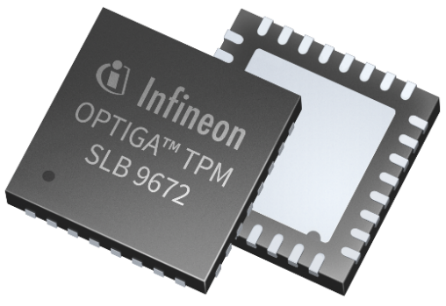

Infineon has already taken the first steps into the world of quantum computing
Infineon’s
OPTIGA™ TPM family …
offers the first TPMs on the market
with a PQC-protected firmware
update mechanism
Launched in
February 2022
Launched in
September 2022

Slide 15



The key benefits with Infineon’s newest TPM family member
Future-proof
Robust security
Easy integration
PQC-protected firmware update mechanism
Extended memory
Stronger cryptographic algorithms
Improved computational performances
Resiliency features
Fully compliant with the TCG requirements and certified accordingly
Standardized Root of Trust
Tools to support design activities
Supports the latest version
of Windows and Linux
Notes:
Resiliency features to avoid the impacts of a corrupted firmware

Slide 16




OPTIGA™ TPM SLB 9673, a future-proof TPM
Previous generation TPM
OPTIGA™ TPM SLB 9673
Firmware update
Firmware update
ECDSA
ECDSA
XMSS
XMSS
Quantum resistant
Improvements
New stronger
crypto algorithms
RSA 3k & 4k
SHA-384, ECC 384
Resiliency
features
To avoid any risk
of FW corruption
TCG certified Version 2
As per Revision 1.38
TCG certified Version 2
As per Revision 1.59

Slide 17
OPTIGA™ TPM SLB
9673
FW 26.xx
9672
FW 15.xx
9672
FW 16.xx
OPTIGATM TPM SLB
Interface
I²C
SPI
SPI
Network infrastructure and light industrial machines such as factory robots, Programmable Logic Controllers (PLC)
MSFT Windows environment/
ecosystem and connected devices
with a “PC platform” architecture
Connected devices supporting enhanced security features (Chip Unique ID readout; AES encryption and decryption;
Disabling EK key deletion)
Optimized for
Temperature range
Extended: -40°C to +85°C
Extended (Industrial): -40°C to +105°C
Standard: -20°C to +85°C
Extended: -40°C to +85°C
Extended: -40°C to +85°C
Extended (Industrial): -40°C to +105°C
Interface speed
Flexibility in terms of interface speed
100 kHz – I2C Standard Mode
(lowest speed)
400 kHz – I2C Fast Mode
1MHz – I2C Fast Mode plus
33 MHz
33 MHz
Availability
July 2022
(with CC-certification)
Available
Available

Slide 18
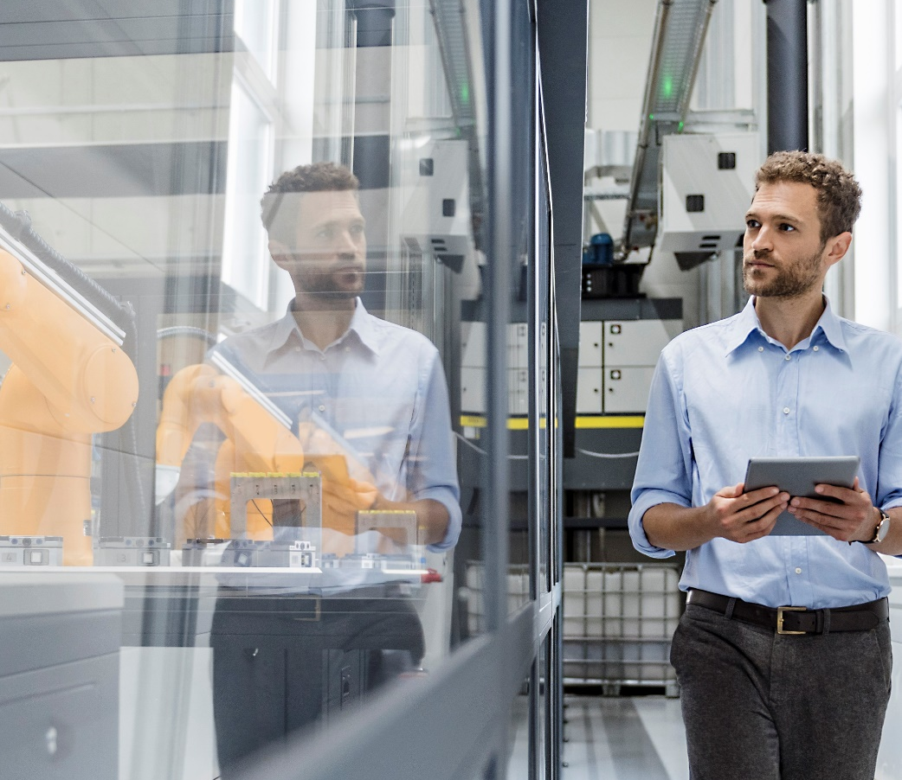
The benefits of
a hardware-based security

Slide 19



Why hardware-based security?
No security
Open for all to see
Software
security only
Hardware
security
Reading
Hardware chip protects itself against
code reading
Software code easily readable by attackers
Copying
Software code easily copied and shared
by attackers
Security hardware must be reverse
engineered and re-manufactured
Analyzing
Software code easily analyzed and understood
using standard tools
Hardware protection for data processing,
transport storage
Root of Trust
Consequently, not so strong “Root of Trust”
anchor for the system
Strong “Root of Trust” anchor for the system, providing detection, recoverability, secured updates

Slide 20









Relying on Infineon’s hardware-based security protects secret keys against software vulnerabilities in OS and Apps
Why software security is often not enough?
Apps
Apps
Operating System
Operating System
Memory
Memory
Hardware
Hardware
Secret keys kept in the shared memory
Secret keys securely kept in the OPTIGA™ TPM

Slide 21


Security adds value by protecting your business, enabling growth and saving costs
Protecting
Trust and reputation
IP and process know-how
Long-term revenue & profitability of investments
Enabling
Growth
New business models
Security as a differentiation factor
Saving
Costs by preventing security-related system interruptions
Cost based on new ways of solving a problem
Notes:
Security adds value by protecting your business, enabling growth and saving costs

Slide 22

Why the OPTIGA™ TPM family

Slide 23

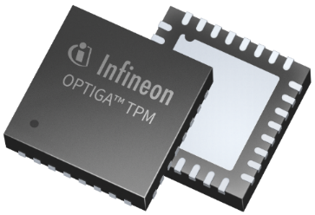
Every second business laptop comes with an OPTIGA™ TPM
FW
updateable
TCG
TPM 2.0
standard
Security certified
(CC and FIPS)
Unique embedded certificates
Tamper resistant
Variety of encryption algorithms
Turn-key system solution (HW+SW)
Complete toolset available
Rich set of security functions

Slide 24




Our solution comes with service and support
We support you by …
Providing Design-In Application Notes for our Products
Host side integration support
Evaluation Kits
Providing a secured Public Key Infrastructure
Custom certificate loading
in secured Production Environment
Answering questions immediately
Two Level Customer
service
Providing trainings for our security products
Showing Demo Applications as a starting point for custom designs

Slide 25

Key take-aways
Security …
… is essential and HW-based security provides
benefits beyond strong security including time to market,
logistics and scalability
New requirements …
… coming in near the future because of quantum
computers and the threat to existing
cryptographic algorithms
OPTIGA™ TPM SLB 9673 …
… with a PQC-protected update mechanism
and an I2C inter-face suited for network infrastructure,
light industrial machines such as factory robots,
and Programmable Logic Controllers (PLC)

Slide 26

Find out more information and tools on the
OPTIGA™ TPM SLB 9673 product page
and our
Github repository

