Slide 1


ISOFACE™ Digital Input ICs –
Product Presentation
ISO2I828V
June 2026

Slide 2
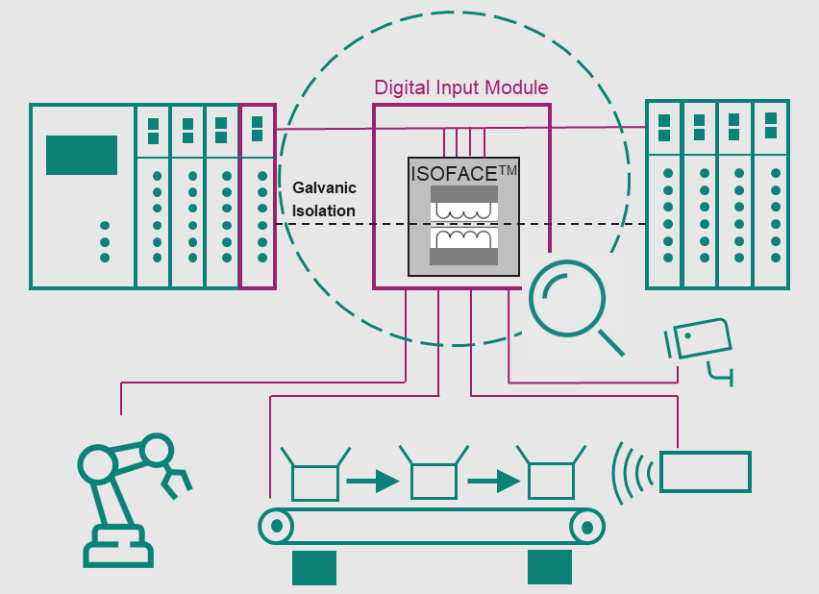
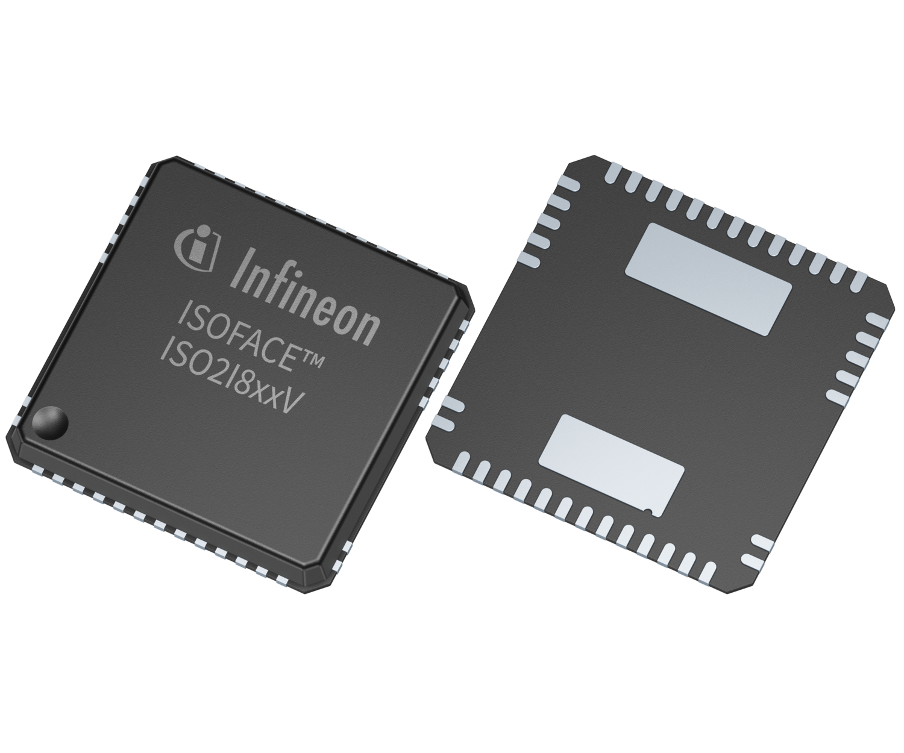
Infineon Digital Input ICs
Introduction to industrial automation applications
What is the function of Input ICs?
What are the key pain points in the application?
Production lines need to run 24/7, requiring an interruption-free operation for high production throughput
Ideally, potential equipment failures can be detected before they occur (predictive maintenance) and fixed most efficiently
Therefore, Digital Input modules must operate reliably even in noisy environments:
  For a given module architecture, the physically available power budget must not be exceeded. Therefore, Digital Input ICs require low contribution to the overall module power dissipation
  Elevated robustness towards noise (e.g. via Input filters, EMC/ CMTI robustness) is required
  In case of over-temperature, a good heat dissipation of the IC helps to avoid production stillstand
  Diagnostic functionality provides the required field data to quickly detect the specific equipment failure which can be fixed more efficiently
ISOFACETM digital Input ICs perfectly address those customer pain points, enabling robust and smart factories
ISOFACETM digital Input ICs are IEC61131-2 compliant system solution ICs for digital input modules primarily used in PLC applications.
In this application, they provide:
  the interface between 24V process and 3.3V/5V control side by evaluating sensor data and transmitting the logic state to the PLC
  an integrated galvanic isolation to protect the 3.3V control side from the harsh 24V process side
  system monitoring via sophisticated diagnostics

Slide 3
Table of contents
1
Value proposition and customer value
3
2
Our offering to help customers to stay ahead
  7
3
Where to get more information to get started
  27

Slide 4




The ISOFACETM Digital Input IC ISO2I828V is the perfect fit for Input modules in industrial automation, robotics and wind power
Industrial automation
Robotics
Wind power
Future smart factories require advanced system monitoring, efficient maintenance and low downtimes.
A full turnkey I/O solution with integrated isolation and compatibility with various types of PLCs is considered as a clear benefit.
Long-term reliability combined with advanced and remote system monitoring is essential to reduce costly maintenance.
Advanced diagnostics and noise robustness enable smart and reliable production.
Low power dissipation and optimized heat distribution help the module Designer to stay within the module’s power budget and prevents heating up neighboring modules.
High level of integration
All ISOFACETM Digital Inputs are compliant with IEC 61131-2 and configurable to different sensor types
Robust isolation without degradation from aging or temperature with 20+ years volume production
Warning flags signal the deviation of key system parameters
A defective sensor wiring is detected and located reliably

Slide 5
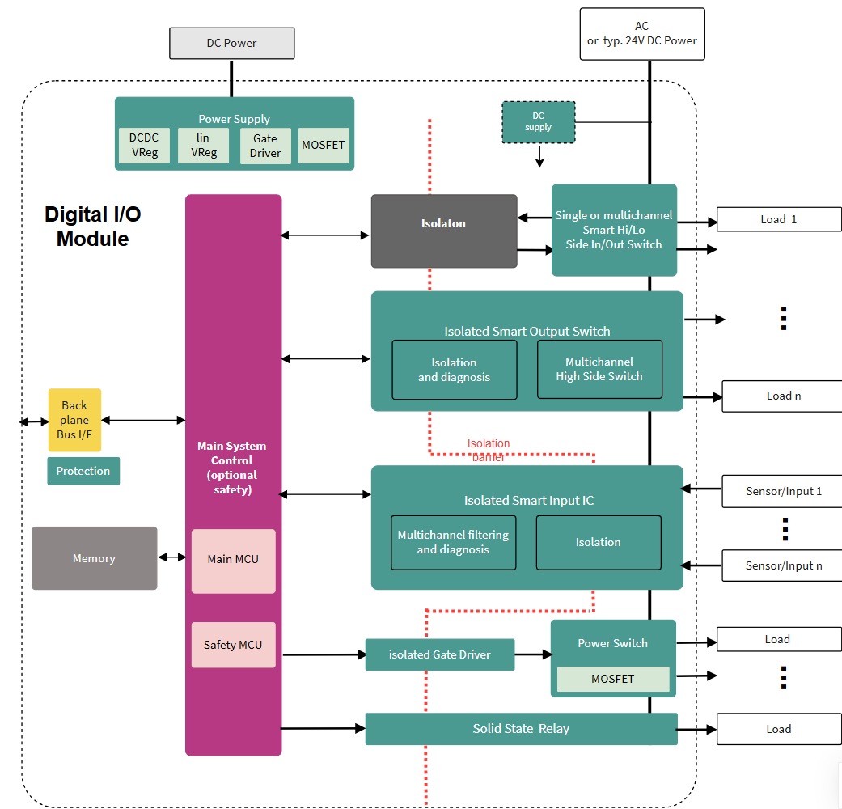
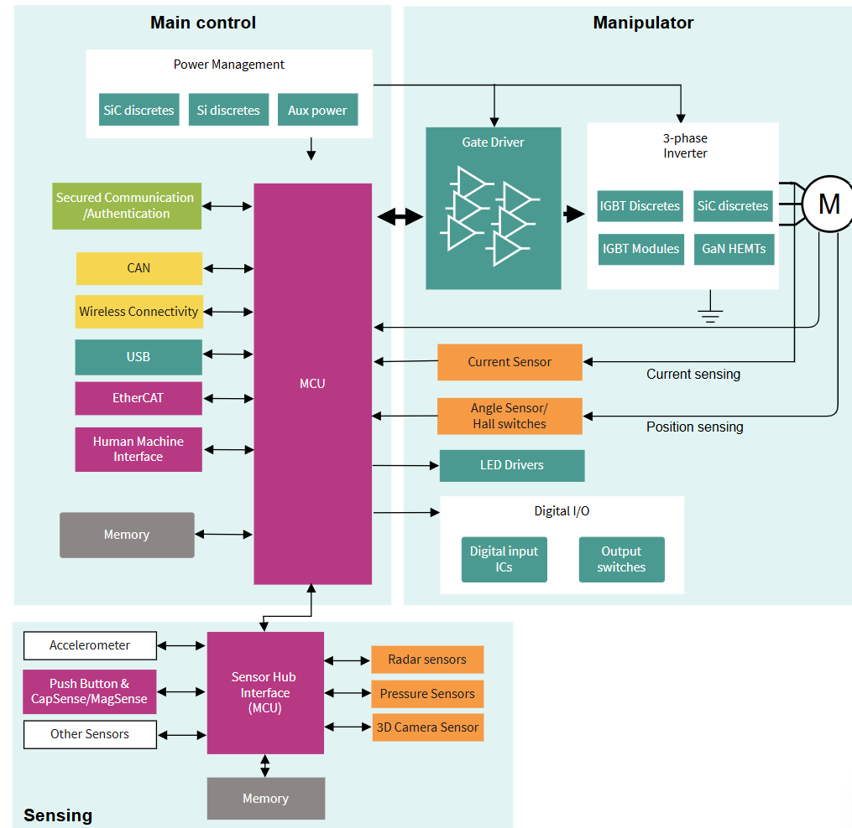
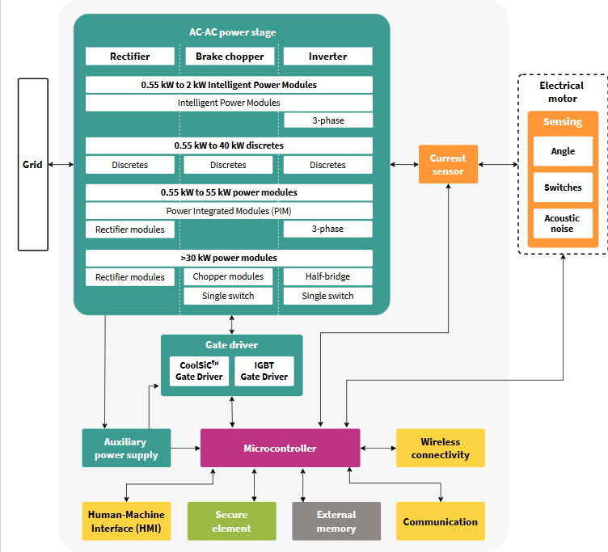
The ISOFACETM Digital Input IC ISO2I828V is the perfect fit for Input modules in industrial automation, robotics and wind power
Industrial automation
Robotics
Wind power
Digital I/O
Digital Input ICs are part of the Digital I/O module. They evaluate sensor data and transmit the logic state to the PLC.
Digital Input ICs are located in the control box and allow an easy integration of the robot system into the overarching PLC process flow.
Digital Inputs are typically part of smaller PLCs in each wind turbine which are used to adjust pitch and yaw.

Slide 6

Digital Inputs in Industrial automation application
Addressing key application trends and requirements
Size
Improved production throughput
Predictive and efficient maintenance
Higher number of channels, while formfactor remains constant/ shrinks leading to less available space for components
Input IC Requirement:
  IC needs to be optimized for power dissipation and heat distribution (loss-free status LED, high-precision sensor current limitation)
  Integration of components to save PCB space, reduce pick&place costs and increase circuit reliability
Faster pace of synchronized process steps
Avoid production stillstand due to over-temperature or noise
Input IC Requirement:
  Short input-to-output delay times (with low temperature dependencies)
  Input filter for increased noise immunity
  High EMC and CMTI robustness
  CRC (cyclic redundancy check) ensures error-free SPI data communication
Detect equipment failures before they occur
Precisely locate the source of equipment failure for efficient maintenance
Input IC requirement:
  Warning flags to signal the deviation of key system parameters (voltage, temperature)
  Detection of defect sensor wiring (channel-resolved wire-break detection)

Slide 7
Table of contents
1
Value proposition and customer value
  3
2
Our offering to help customers to stay ahead
7
2.1
Product benefits in the context of the market/application trends
2.2
Infineon’s product family positioning
2.3
Product one-pager overviews
2.4
Product portfolio table – differentiation of product variants
2.5
Kits/boards overview
3
Where to get more information to get started
  27

Slide 8
Introduction to Infineon’s ISOFACE™ Digital I/O ICs in industrial automation
Digital Input and Output ICs
Provide the interface between the 24V process and 3.3/5V contol side and transmit the logic state between PLC and sensors or actuators.
Are highly integrated system solution ICs for compact designs, reducing required PCB size and BOM
Facilitate predictive and efficient maintenance and a stable and reliable production throughput through comprehensive diagnostics
Are compliant with the PLC norm IEC 61131-2 and therefore accelerate the customer’s Design-IN process
Digital Outputs
Digital Inputs
Input ICs evaluate sensor data, transmit the logic state to the PLC and precisely limit the sensor current
8 digital input channels configurable to sensor types I,II and III according to IEC 61131-2
Up to 500 kHz sampling frequency
Optional V_{BB} self-supply with integrated DC-DC Converter
Output ICs receive the logic state from the PLC and drive the corresponding actuators
8-channel high-side power switches with current capability of up to 0.6A or 1.2A per channel
Incorporate various protection features like short-circuit protection and current limitation
Industry-leading robustness for switching-off inductive loads

Slide 9
ISOFACETM Digital Input and Output ICs
Product family positioning
ISOFACETM Digital I/O ICs
NEW
Digital Input ICs Gen-1
Digital Input ICs Gen-2
Digital Output ICs Gen-1
Digital Output ICs Gen-2
ISO1I813T
ISO1I811T
ISO2I828V *
ISO1H801G
ISO1H811G
ISO2H823V2
Part number
ISO1H812G
ISO1H815G
Part number
ISO1H816G
Part number
Key differentiating features of the product family:
Key differentiating features of the product family:
Key differentiating features of the product family:
Key differentiating features of the product family:
8 digital input channels according to IEC 61131-2 (Type 1/2/3)
Both 3.3V and 5V SPI and parallel microcontroller interface
Optional V_{BB} self-supply with integrated DC-DC Converter (ISO1I813T)
8 digital input channels according to IEC 61131-2 Type 1 and Type 3
Robust 2.5 kV_{RMS} galvanic isolation
Supply and sensor voltage V_{BB} up to 60V max for high system robustness
Event-based interrupt flag supports optimized microcontroller data traffic
Optimized power dissipation due to precisely regulated sensor input current
Small footprint VQFN-40 (8x8 mm)
8-channel high-side power switch with current capability of up to 1.2A/ channel
Industry-leading robustness for switching-off inductive loads (1J per channel at 0.6A, Tj = 125 °C)
Both 3.3V/ 5V microcontroller interface
Global diagnostic feedback (overtemperature, overload)
8-channel high-side power switch with current capability of up to 0.6A/ channel
Configurable 8/16/24-bit SPI and parallel modes
Robust 2.5 kV_{RMS} galvanic isolation
Industry-leading global and channel-resolved diagnostics stored in registers
Small footprint VQFN-70 (12x12 mm)
* Coming soon

Slide 10
ISOFACE™ Digital Input ICs
Portfolio comparison
 |  | Gen-1 |  | Gen-2
Feature |  | ISO1I811T | ISO1I813T | ISO2I828V
Input characteristics | IEC type: I, II, III | I,II,III | I,II,III | I, III
 | Max. field supply & sensor voltage | 45 V | 45 V | 60 V
 | Input status LED | ✓ | ✓ | ✓
 | Max. sampling frequency | 125 kHz | 500 kHz | 500 kHz
 | Sink current regulation | 2.3mA – 3.4mA (24V) | 2.3mA – 3.4mA (24V) | 2.1mA – 2.5mA (24V/ 48V)
 | Deglitching filter setting | Hardwired | Configurable | Configurable
 | Synchronous data acquisition | ✗ | ✓ | ✓
µC interface | 3.3 V/ 5 V | 3.3 V/ 5 V | 3.3 V/ 5 V | 3.3 V
 | SPI and parallel | ✓ | ✓ | ✓
 | Event-based interrupt flag | ✗ | ✗ | ✓
Safety features | Isolation voltage (VISO) | 500 V_{RMS} | 500 V_{RMS} | 2.5 kV_{RMS}
Diagnostic feedback | Wire-break, channel-specific | ✗ | ✓ | ✓
 | VBB low level detection | 1 level | 3 levels | 2 levels
 | Further diagnostics | ✗ | ✗ | overtemperature, overvoltage
VBB self-supply (integrated DC-DC) |  | ✗ | ✓ | ✗
Package |  | TSSOP-48 (8x12.5 mm) | TSSOP-48 (8x12.5 mm) | VQFN-40 (8x8 mm)

Slide 11
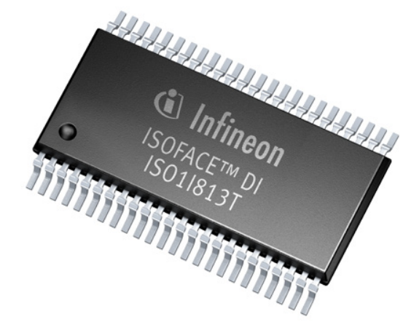
ISOFACE™ Digital Input ICs
Key differentiations vs. discrete Digital Inputs
Complete system integration, for higher performance @ low BOM
Key functionalities are integrated into one IC (level detection, current limitation, galvanic isolation, diagnostic), reducing complexity and BOM
An integrated SPI interface allows to configure digital filters and diagnostics per channel
Optimized current regulation and channel matching
1
Comprehensive diagnostics for predictive & efficient maintenance
2
Warning flags signal the deviation of key system parameters (voltage, temperature) and help to detect failures before they occur
Defective sensor wiring is detected per channel, leading to more efficient maintenance
ISO1I8xxT
ISO2I8xxV
3
Improved production throughput
Speed is not limited by an Optocoupler. The integrated Coreless transformer (CT) is faster.
Synchronized communication to the µC between different modules

Slide 12

ISOFACETM Digital Input IC ISO2I828V offers reliable operation in harsh industrial environments
Key Features
Key Benefits
Value Proposition to
Customer
Robust Coreless Transformer technology with 2500 V_{RMS} isolation voltage
Optimized heat dissipation of IC on PCB level (R_{thJB} 8K/W)
Supply voltage V_{BB} (field chip) up to 60V abs. max
High system robustness even in corner cases:
  No degradation of isolation from aging or temperature
  Proven lowest field failure rates
High reliability
Complete system integration in a 35% smaller package versus Gen 1 (8x8 mm VQFN-40-24)
Tailored to different applications due to configurability of IC (including 48V sensors)
Optimized power dissipation (low sensor input current 2.1 to 2.5mA/ power consumption ≤ 648mW)
Small module size at high channel density
Less complexity
Lower system cost
Small PCB size & low BOM
Ease of design-in
Reduced factory installation times
Efficient maintenance due to accurate system feedback
High Production Throughput
Reduced Down-Times
Comprehensive channel-resolved diagnostics including overtemperature and over-voltage alarm
1) 648 mW (all 8 channels @ 24V, 2.5 mA, 500 kHz); Including IC consumption, external components and VBB and VDD supply

Slide 13
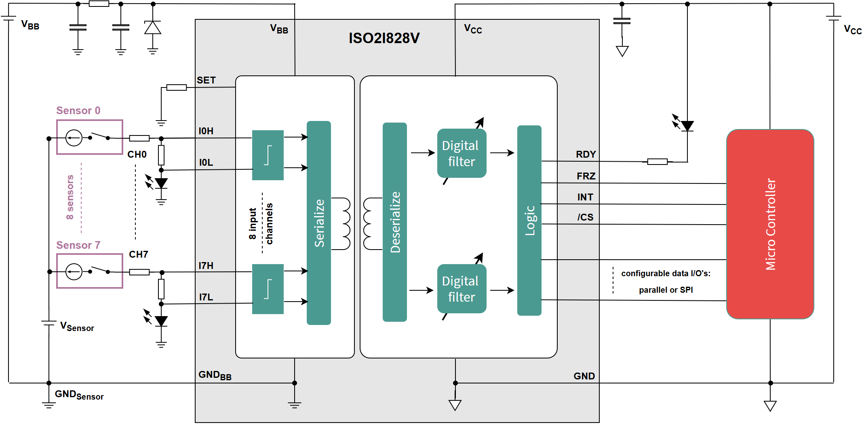
ISOFACE™ ISO2I828V Digital Input IC overview
Availability Samples: ES 08/26 | Production start: 11/26
Product highlights and benefits
Key specifications
8 digital input channels compliant with IEC 61131-2 Type 1 and Type 3
3.3V microcontroller interface with 8/16/24 bit SPI, parallel and optocoupler emulation mode
Robust 2.5 kV_{RMS} galvanic isolation (UL1577 pending)
Optimized power dissipation due to precisely regulated sensor input current (2.1-2.5mA)
Supply and sensor voltage V_{BB} up to 60V max for high system robustness
Comprehensive Diagnostics: sensor wire-break, overtemperature, V_{BB} level monitoring
Configurable sampling frequency: 20 kHz, 200 kHz or 500 kHz
Event-based interrupt flag supports optimized microcontroller data traffic
Small footprint VQFN-40 (8x8 mm)
Part number | µC interface | Isolation voltage (VISO) | Field supply & sensor voltage | Diagnostics | Package
Gen-2: ISO2I828V | 3.3V | 2.5 kV_{RMS} | 60V | Wire-break, overtemperature, V_{BB} monitoring | VQFN-40 (8x8 mm)
Gen-1: ISO1I813T | 3.3V/5V | 500 V_{RMS} | 45V | Wire-break, V_{BB} monitoring | TSSOP-48 (8x12.5 mm)
Typical applications
PLC
Industrial automation
Robotics
Wind power
CNC machinery
Cobots
Industrial drives
Typical connection diagram/application diagram
Product information
Link to data sheet
Link to product/product family web page
Reference Board (~September 2026)
VQFN-40
(8x8 mm)
Status: Coming soon

Slide 14
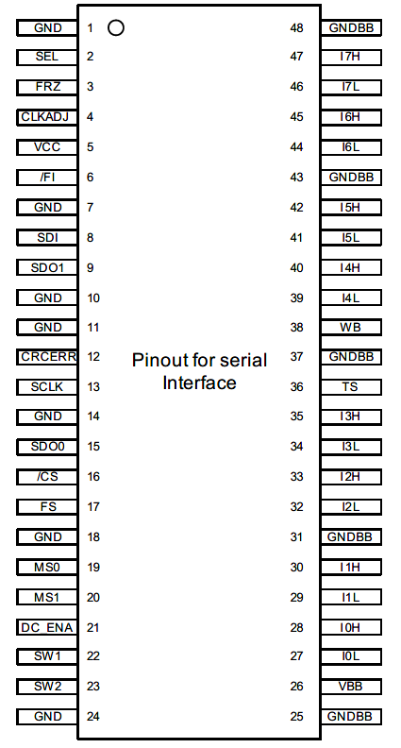
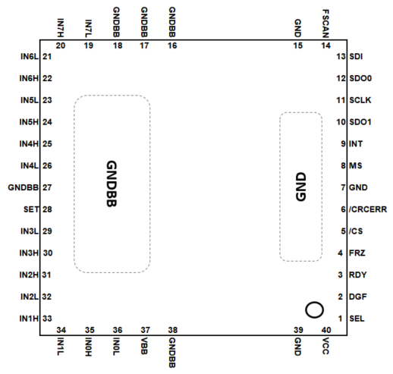
Pinout diagram ISO1I8xxT vs. ISO2I828V
*Not drawn to scale
ISO1I8xxT
ISO2I828V
-35%
8 mm
12.5mm
8 mm
8mm

Slide 15
Product naming nomenclature for ISOFACE Digital Input and Output ICs
ISO
2
I
8
28
V
Package
V: VQFN
G: DSO
T: TSSOP
ISOLATED
Product variant
Generation
1: First generation
2: Second generation
# of channels
Input/ Output IC
I: Input IC
H: Output IC (High-side)

Slide 16

Boards & Designs

Slide 17
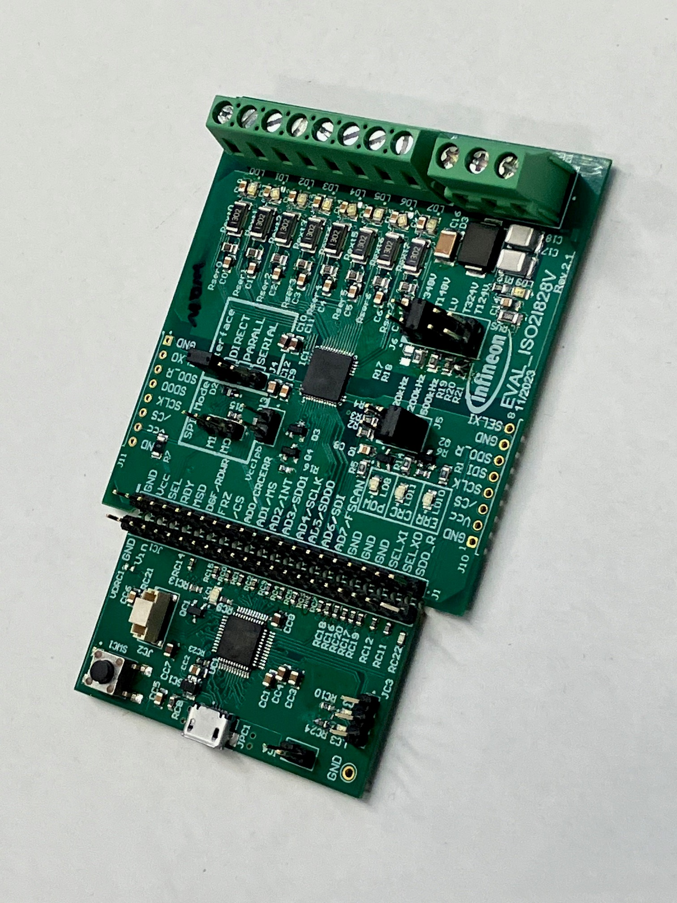
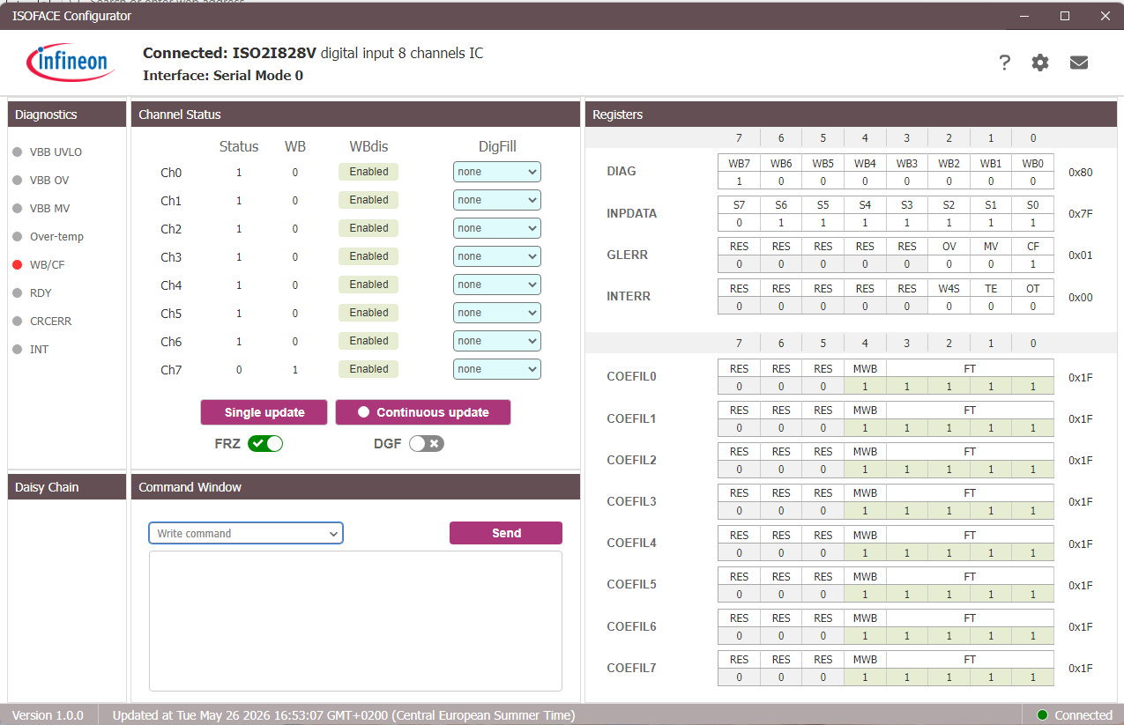
Evaluation Boards
EVAL_ISO2I828V
Go to Board page
Description
Technical and order details
The EVAL_ISO2I828V includes the IC and all external components that are required to set up a complete digital input application. All Input channel functions; operational modes and diagnostic features can be evaluated.
The evaluation board comes with a µC auxiliary board EVAL_ISO2I828V_BK, populated with a pre-programmed µC that can be used to control the IC via open-source terminal software.
Alternatively, a GUI ISOFACE_GUI_1.0 can be used to try out the IC functionality, providing a convenient and quick overview of all register settings of the IC.
Parameter | Value
Field-side voltage | 9.6 V_{DC} ~ 60 V_{DC}
µC-side voltage | 2.5 V_{DC} ~ 3.6 V_{DC}
Sensor voltage | - 60 V - +60 V
Communication | Parallel/Serial (SPI)/ Direct interface to the µC
IFX Components | ISOFACE™ ISO2I828V PSOC™ 4 microcontroller IFX_CY8C4247AZI-L433 Linear VREG: TLS202B1MBV33 Transistors: BSS123N, BSS84PH6327XTSA2 Diode: BAT165
Visualization
GUI
Benefits
Simple configurability via jumper settings (sensor type, sampling frequency, interface type SPI/parallel/direct)
GUI which provides an overview of available register settings
Optional µC auxiliary board allows to operate the board with terminal software
Potential applications
PLC, Industrial automation
Robotics
Wind power
CNC machinery
Cobots
Industrial drives

